Slide 2
Keď sen sa stane skutočnosťou
Notes:
When societies come together and form governments, they create a number of systems. For example we have a transportation system, an education system and a healthcare system.
What is the goal of the Transportation system?
To Move people and things from one place to another.
What is the goal of the education system?
To help us be more educated.
What is the goal of the healthcare system?
To help us be healthier.

Slide 3
Notes:
When societies come together and form governments, they create a number of systems. For example we have a transportation system, an education system and a healthcare system.
What is the goal of the Transportation system?
To Move people and things from one place to another.
What is the goal of the education system?
To help us be more educated.
What is the goal of the healthcare system?
To help us be healthier.

Slide 4
Notes:
When societies come together and form governments, they create a number of systems. For example we have a transportation system, an education system and a healthcare system.
What is the goal of the Transportation system?
To Move people and things from one place to another.
What is the goal of the education system?
To help us be more educated.
What is the goal of the healthcare system?
To help us be healthier.

Slide 5
Notes:
When societies come together and form governments, they create a number of systems. For example we have a transportation system, an education system and a healthcare system.
What is the goal of the Transportation system?
To Move people and things from one place to another.
What is the goal of the education system?
To help us be more educated.
What is the goal of the healthcare system?
To help us be healthier.

Slide 6
Notes:
When societies come together and form governments, they create a number of systems. For example we have a transportation system, an education system and a healthcare system.
What is the goal of the Transportation system?
To Move people and things from one place to another.
What is the goal of the education system?
To help us be more educated.
What is the goal of the healthcare system?
To help us be healthier.

Slide 7
Notes:
When societies come together and form governments, they create a number of systems. For example we have a transportation system, an education system and a healthcare system.
What is the goal of the Transportation system?
To Move people and things from one place to another.
What is the goal of the education system?
To help us be more educated.
What is the goal of the healthcare system?
To help us be healthier.

Slide 8
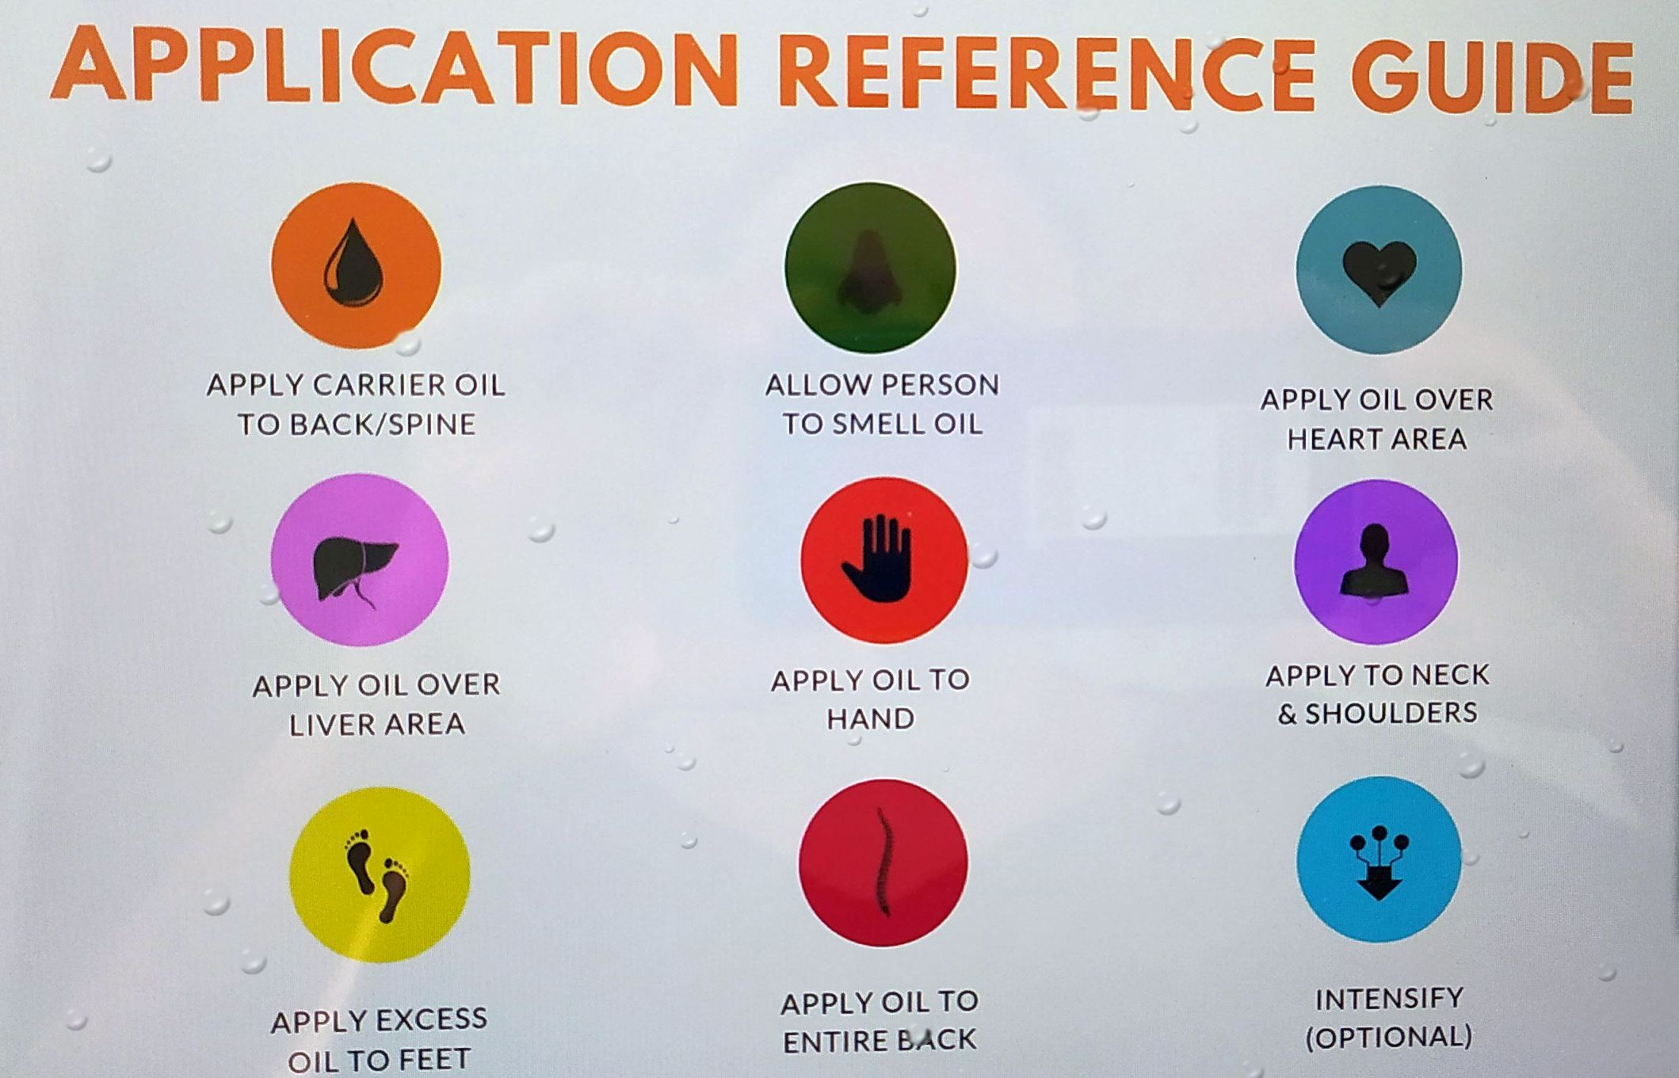
Notes:
When societies come together and form governments, they create a number of systems. For example we have a transportation system, an education system and a healthcare system.
What is the goal of the Transportation system?
To Move people and things from one place to another.
What is the goal of the education system?
To help us be more educated.
What is the goal of the healthcare system?
To help us be healthier.

Slide 9
Notes:
When societies come together and form governments, they create a number of systems. For example we have a transportation system, an education system and a healthcare system.
What is the goal of the Transportation system?
To Move people and things from one place to another.
What is the goal of the education system?
To help us be more educated.
What is the goal of the healthcare system?
To help us be healthier.

Slide 10
Notes:
When societies come together and form governments, they create a number of systems. For example we have a transportation system, an education system and a healthcare system.
What is the goal of the Transportation system?
To Move people and things from one place to another.
What is the goal of the education system?
To help us be more educated.
What is the goal of the healthcare system?
To help us be healthier.

Slide 11
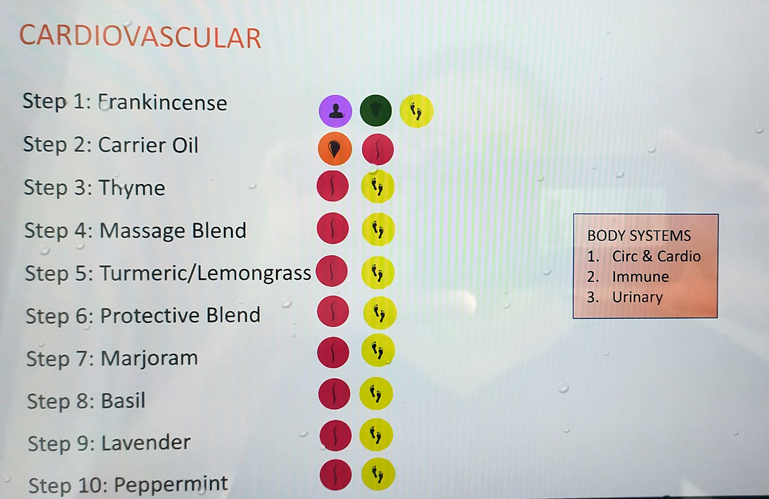
Notes:
When societies come together and form governments, they create a number of systems. For example we have a transportation system, an education system and a healthcare system.
What is the goal of the Transportation system?
To Move people and things from one place to another.
What is the goal of the education system?
To help us be more educated.
What is the goal of the healthcare system?
To help us be healthier.

Slide 12
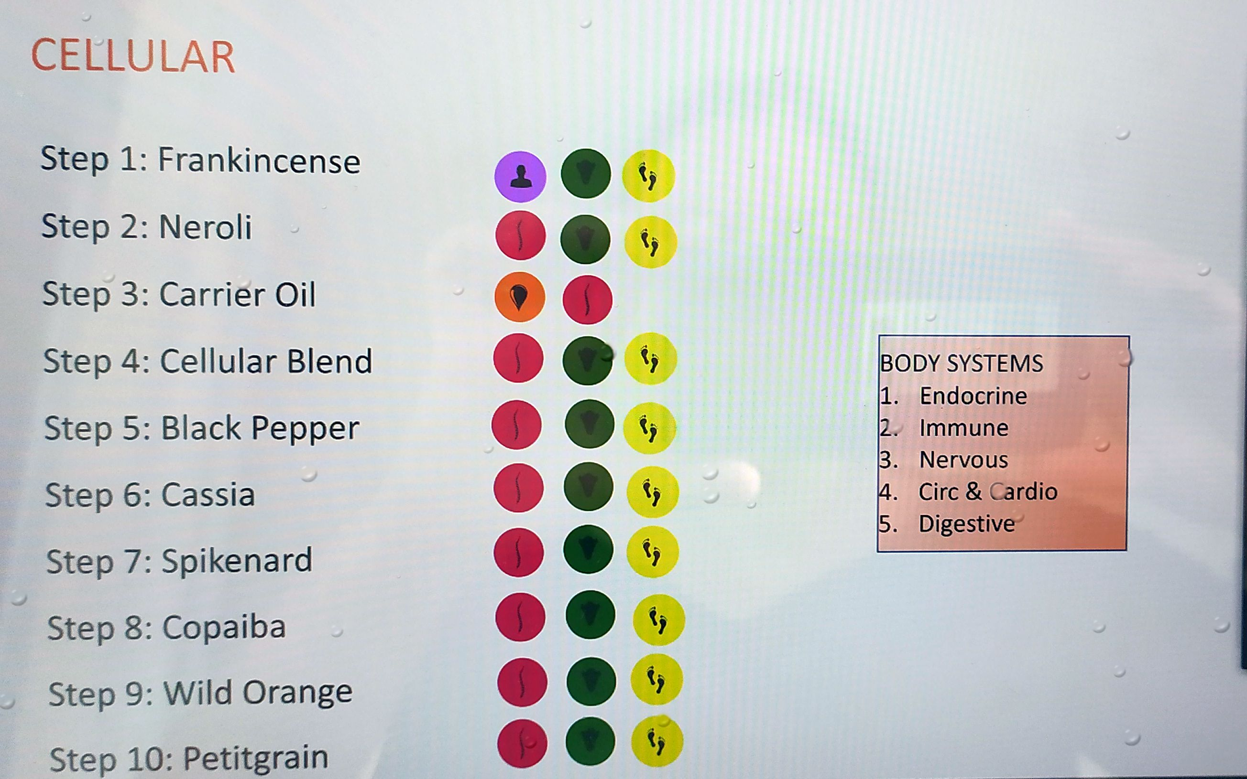
Notes:
When societies come together and form governments, they create a number of systems. For example we have a transportation system, an education system and a healthcare system.
What is the goal of the Transportation system?
To Move people and things from one place to another.
What is the goal of the education system?
To help us be more educated.
What is the goal of the healthcare system?
To help us be healthier.

Slide 13
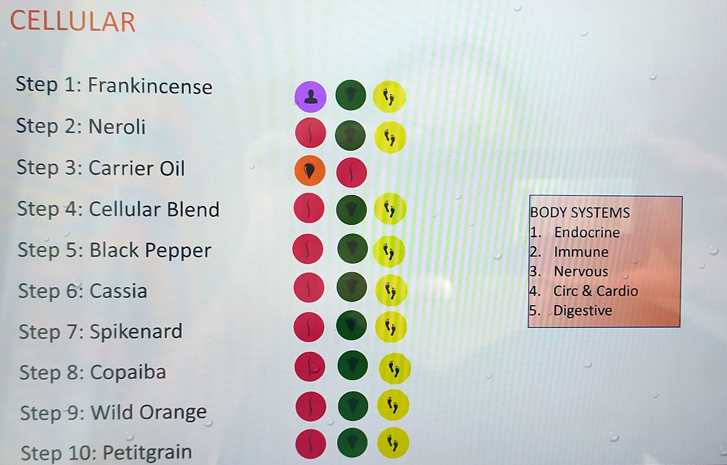
Notes:
When societies come together and form governments, they create a number of systems. For example we have a transportation system, an education system and a healthcare system.
What is the goal of the Transportation system?
To Move people and things from one place to another.
What is the goal of the education system?
To help us be more educated.
What is the goal of the healthcare system?
To help us be healthier.

Slide 14
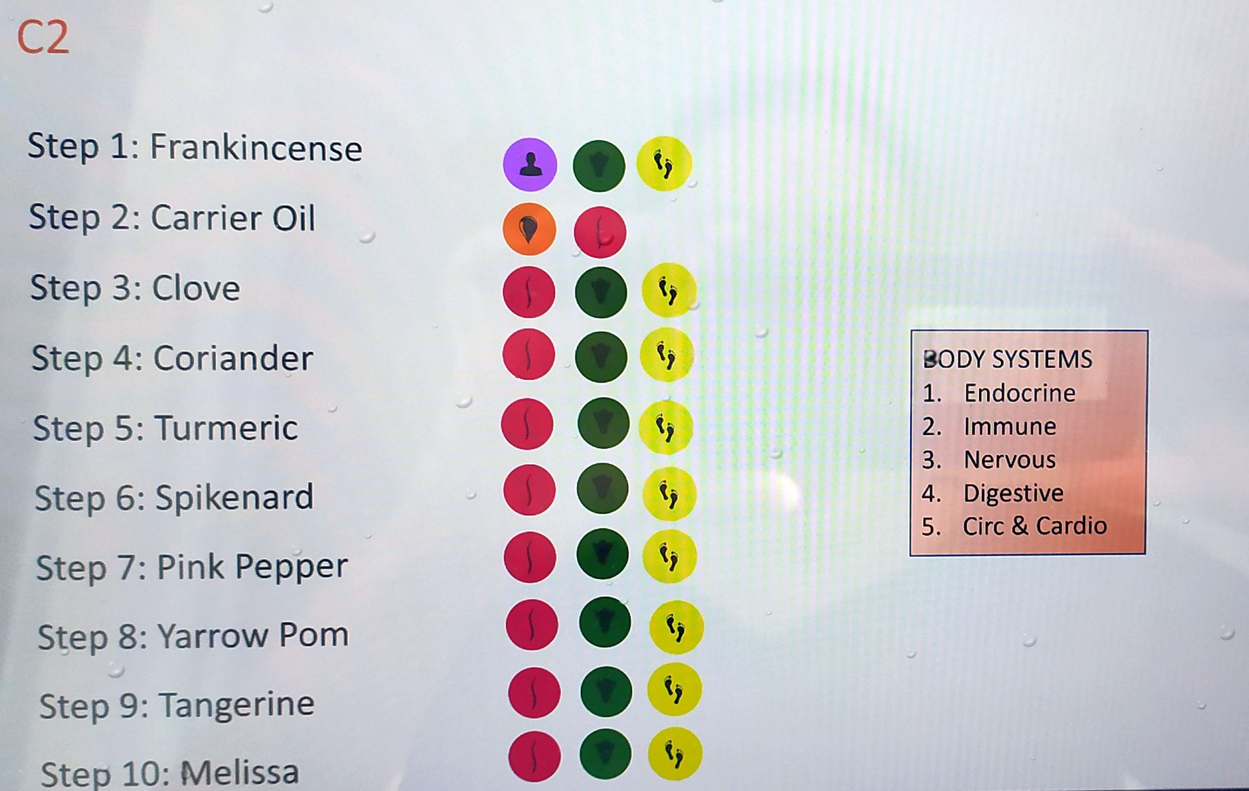
Notes:
When societies come together and form governments, they create a number of systems. For example we have a transportation system, an education system and a healthcare system.
What is the goal of the Transportation system?
To Move people and things from one place to another.
What is the goal of the education system?
To help us be more educated.
What is the goal of the healthcare system?
To help us be healthier.

Slide 15
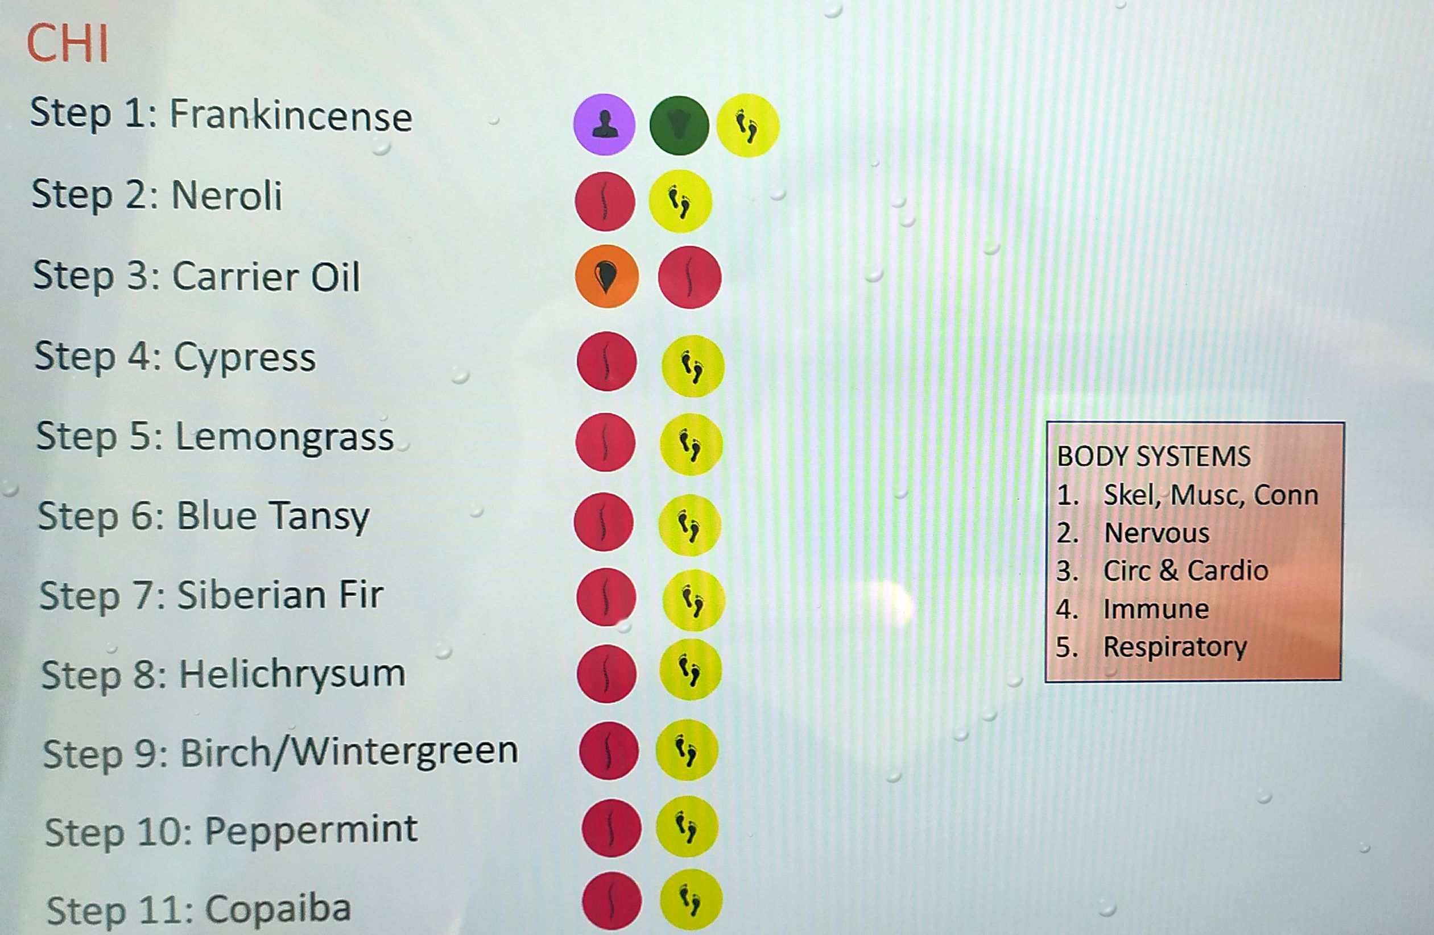
Notes:
When societies come together and form governments, they create a number of systems. For example we have a transportation system, an education system and a healthcare system.
What is the goal of the Transportation system?
To Move people and things from one place to another.
What is the goal of the education system?
To help us be more educated.
What is the goal of the healthcare system?
To help us be healthier.

Slide 16
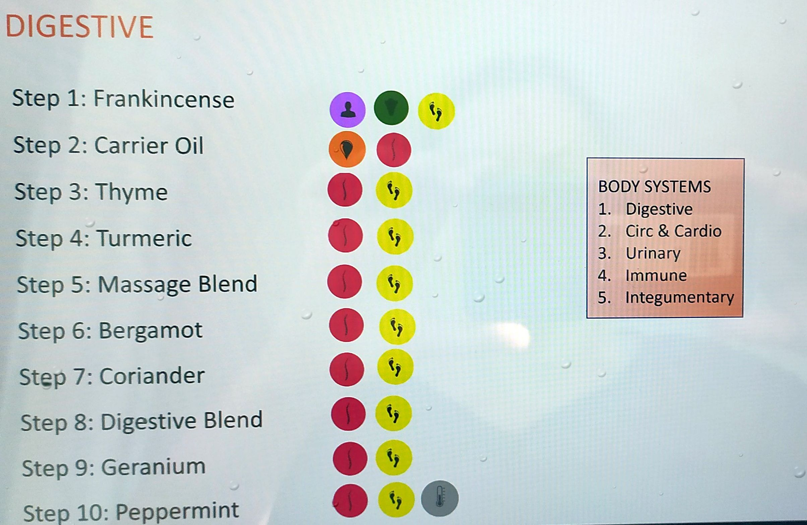
Notes:
When societies come together and form governments, they create a number of systems. For example we have a transportation system, an education system and a healthcare system.
What is the goal of the Transportation system?
To Move people and things from one place to another.
What is the goal of the education system?
To help us be more educated.
What is the goal of the healthcare system?
To help us be healthier.

Slide 17
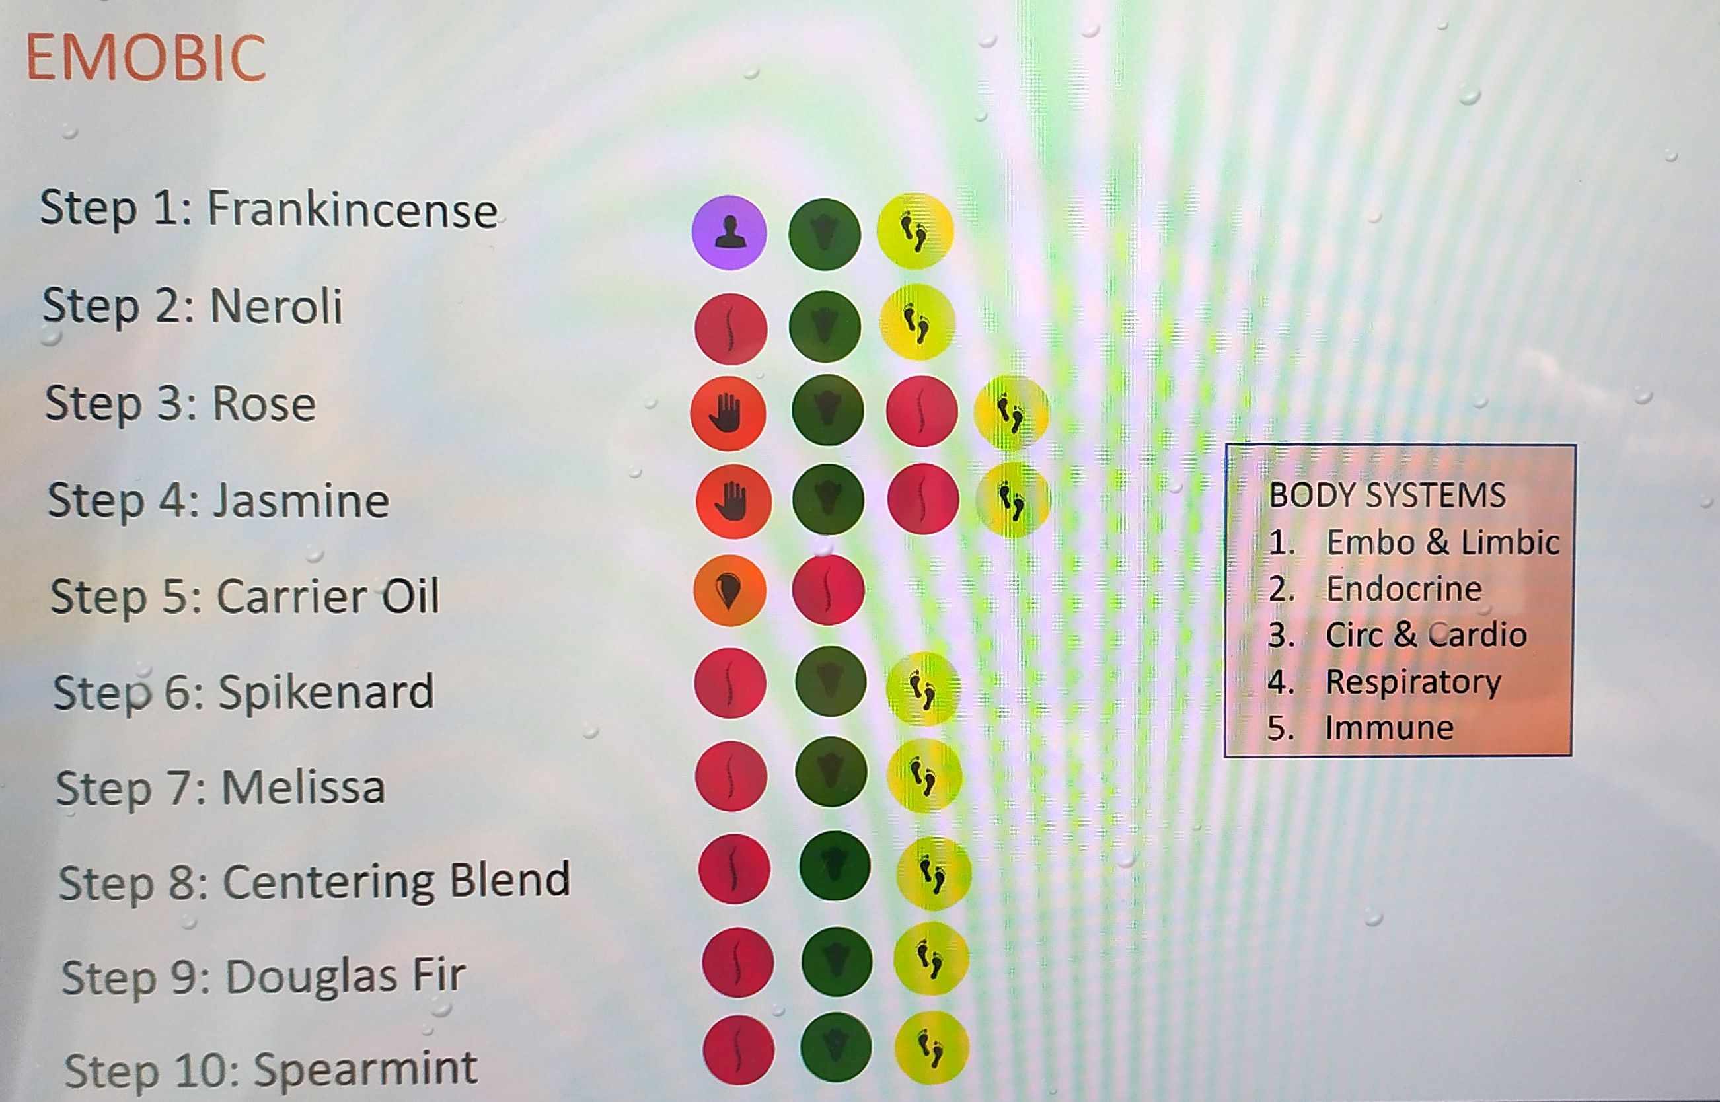
Notes:
When societies come together and form governments, they create a number of systems. For example we have a transportation system, an education system and a healthcare system.
What is the goal of the Transportation system?
To Move people and things from one place to another.
What is the goal of the education system?
To help us be more educated.
What is the goal of the healthcare system?
To help us be healthier.

Slide 18
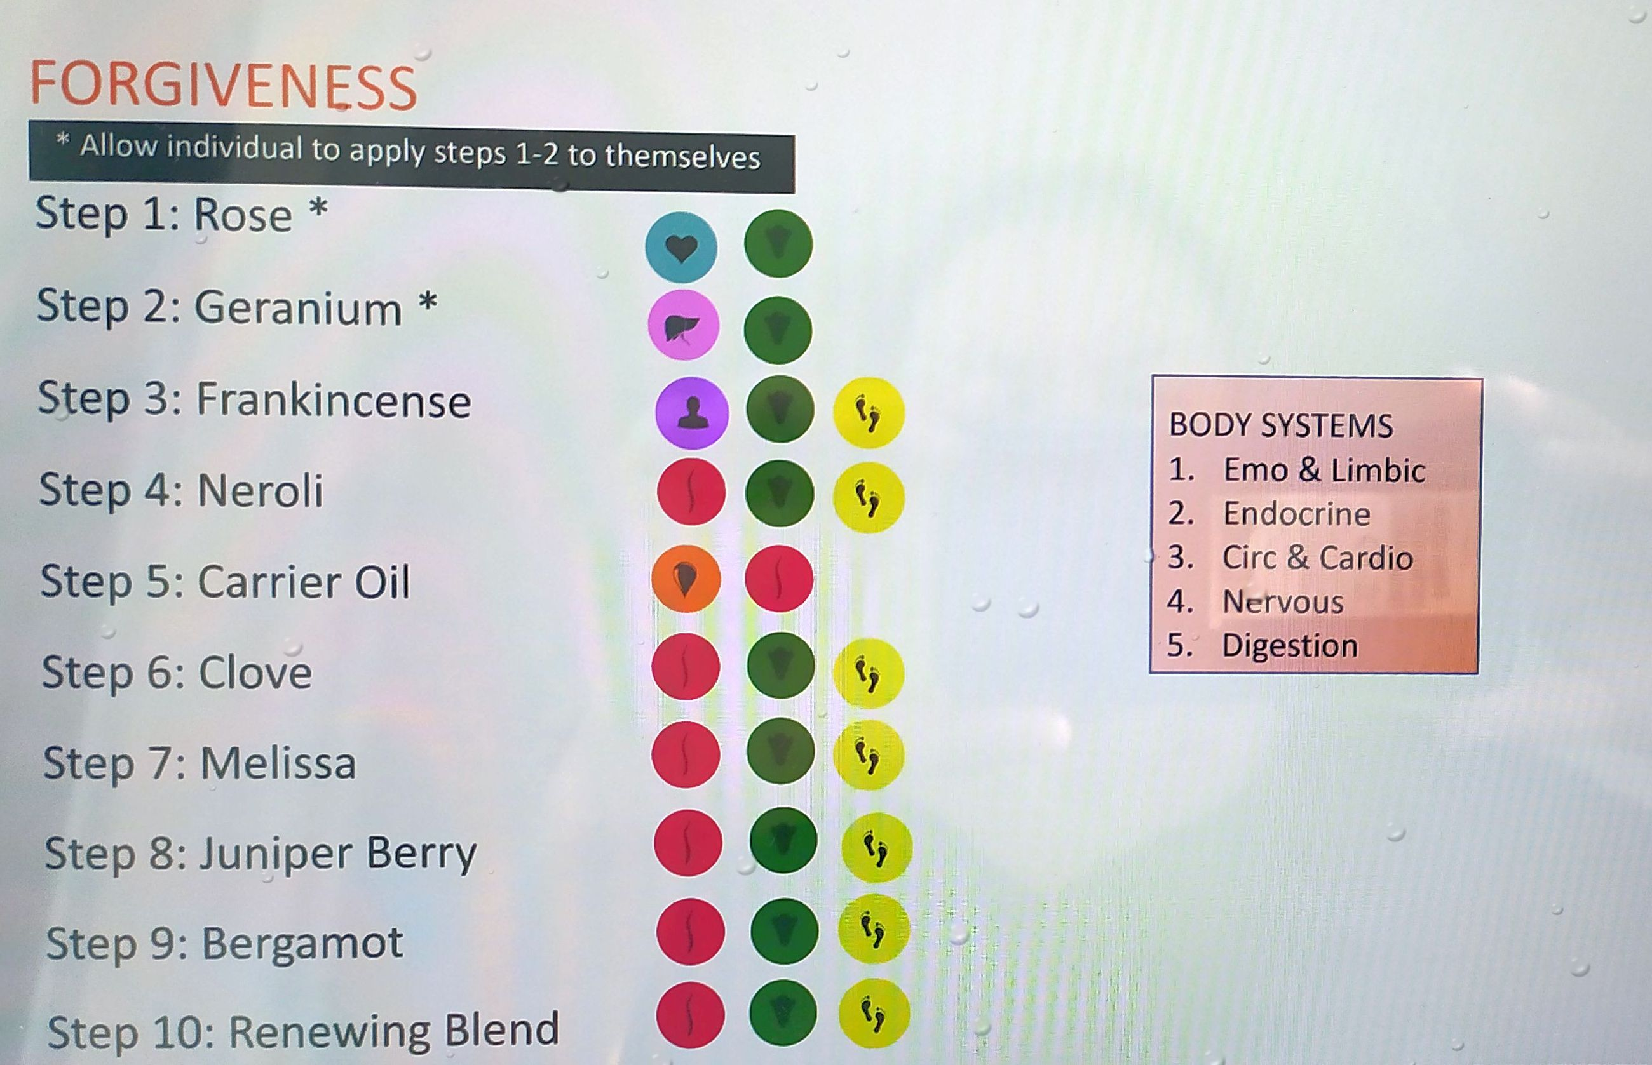
Notes:
When societies come together and form governments, they create a number of systems. For example we have a transportation system, an education system and a healthcare system.
What is the goal of the Transportation system?
To Move people and things from one place to another.
What is the goal of the education system?
To help us be more educated.
What is the goal of the healthcare system?
To help us be healthier.

Slide 19
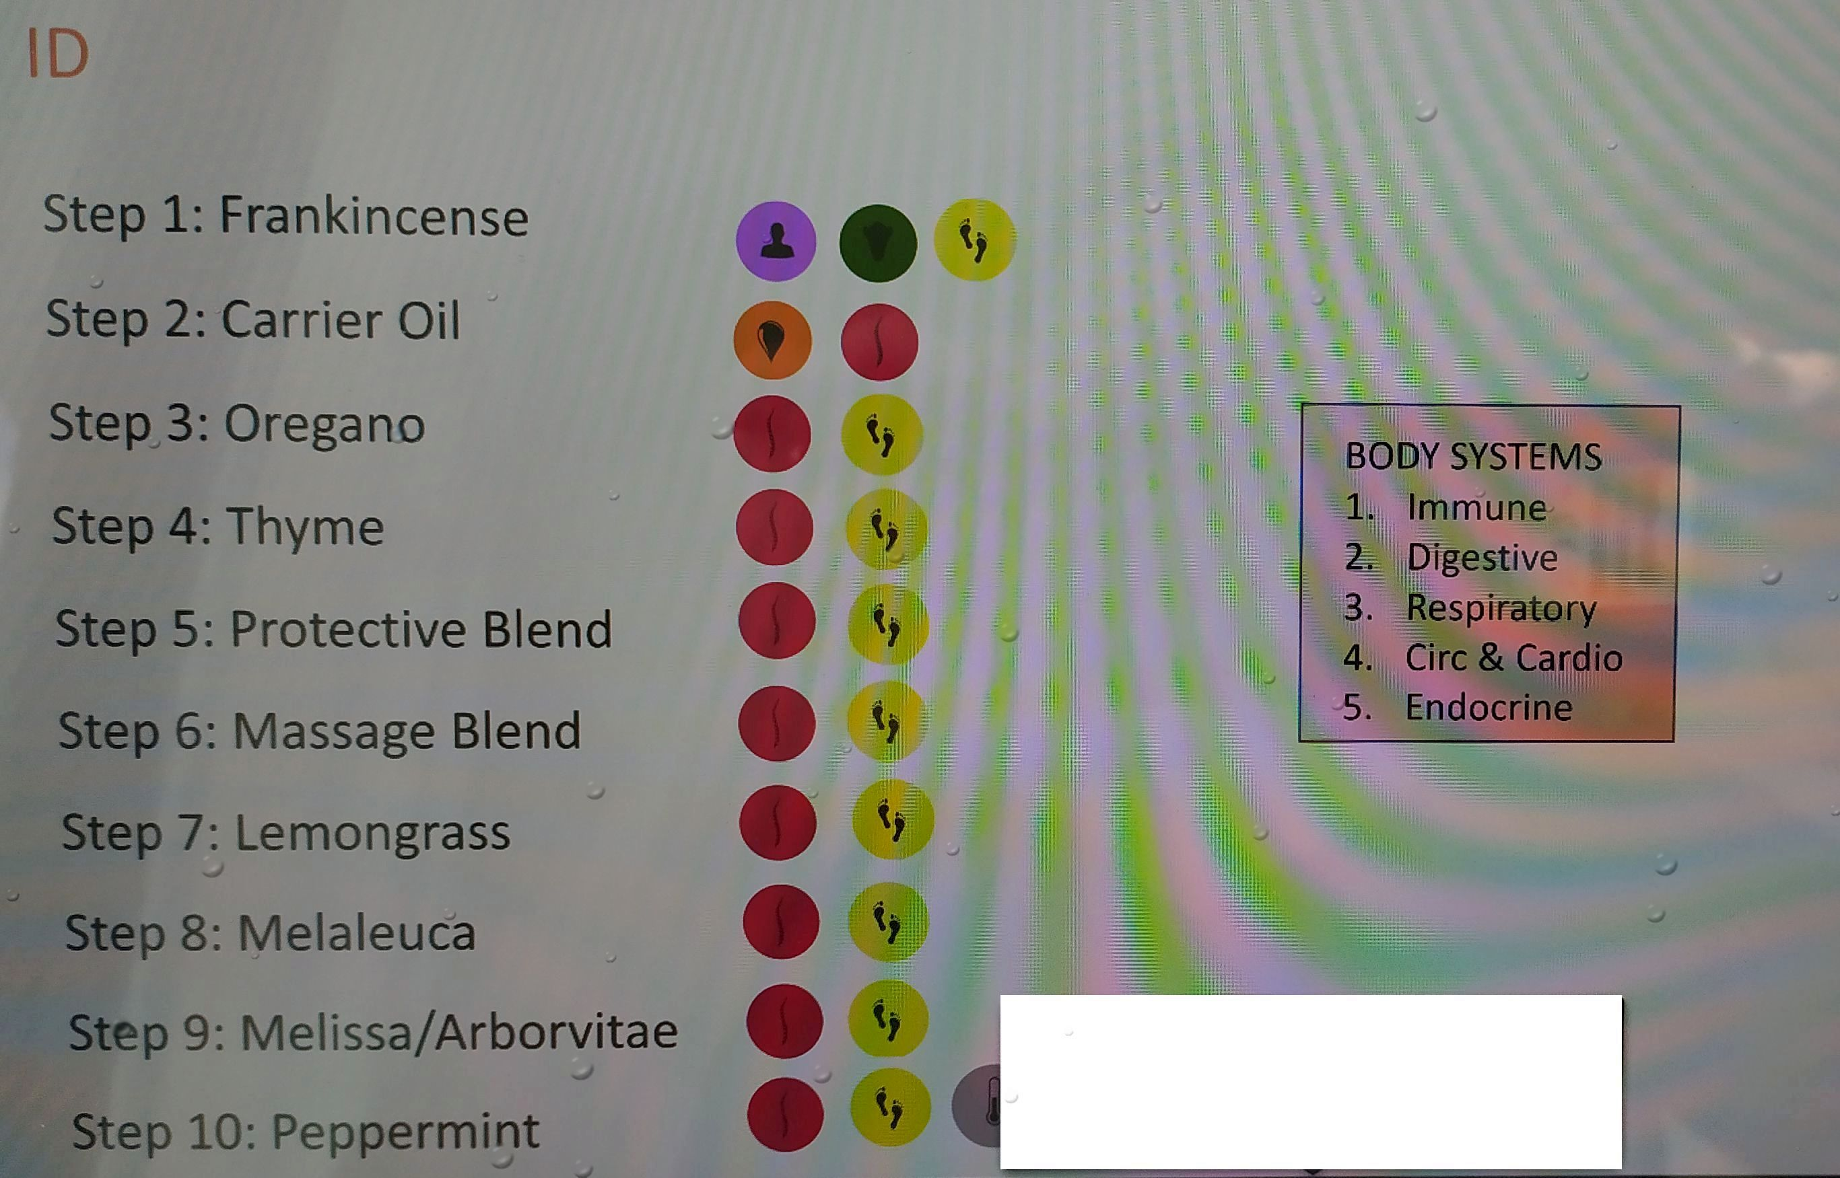
Notes:
When societies come together and form governments, they create a number of systems. For example we have a transportation system, an education system and a healthcare system.
What is the goal of the Transportation system?
To Move people and things from one place to another.
What is the goal of the education system?
To help us be more educated.
What is the goal of the healthcare system?
To help us be healthier.

Slide 20
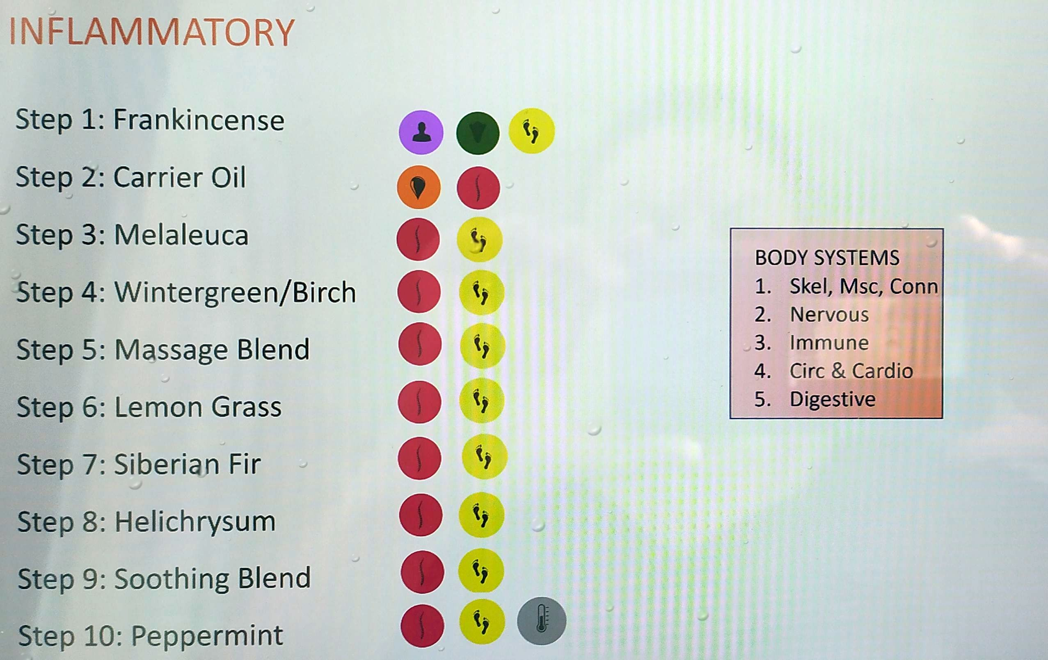
Notes:
When societies come together and form governments, they create a number of systems. For example we have a transportation system, an education system and a healthcare system.
What is the goal of the Transportation system?
To Move people and things from one place to another.
What is the goal of the education system?
To help us be more educated.
What is the goal of the healthcare system?
To help us be healthier.

Slide 21
Notes:
When societies come together and form governments, they create a number of systems. For example we have a transportation system, an education system and a healthcare system.
What is the goal of the Transportation system?
To Move people and things from one place to another.
What is the goal of the education system?
To help us be more educated.
What is the goal of the healthcare system?
To help us be healthier.

Slide 22
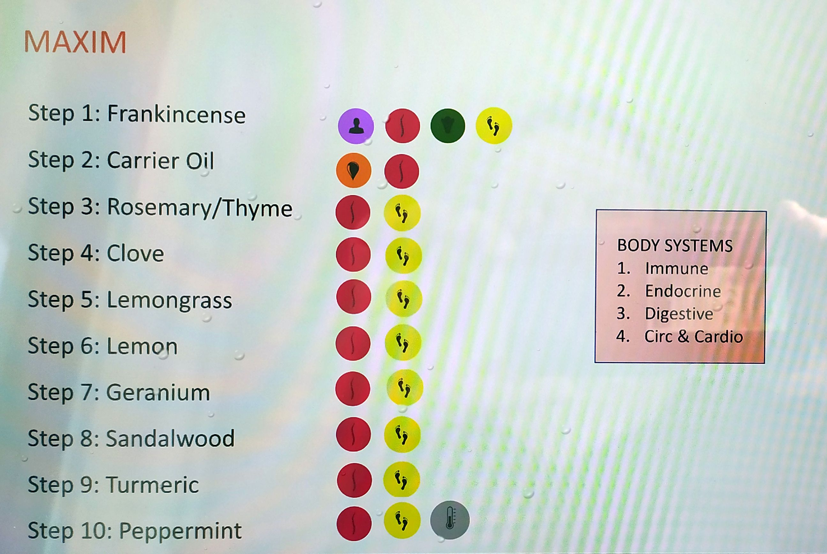
Notes:
When societies come together and form governments, they create a number of systems. For example we have a transportation system, an education system and a healthcare system.
What is the goal of the Transportation system?
To Move people and things from one place to another.
What is the goal of the education system?
To help us be more educated.
What is the goal of the healthcare system?
To help us be healthier.

Slide 23
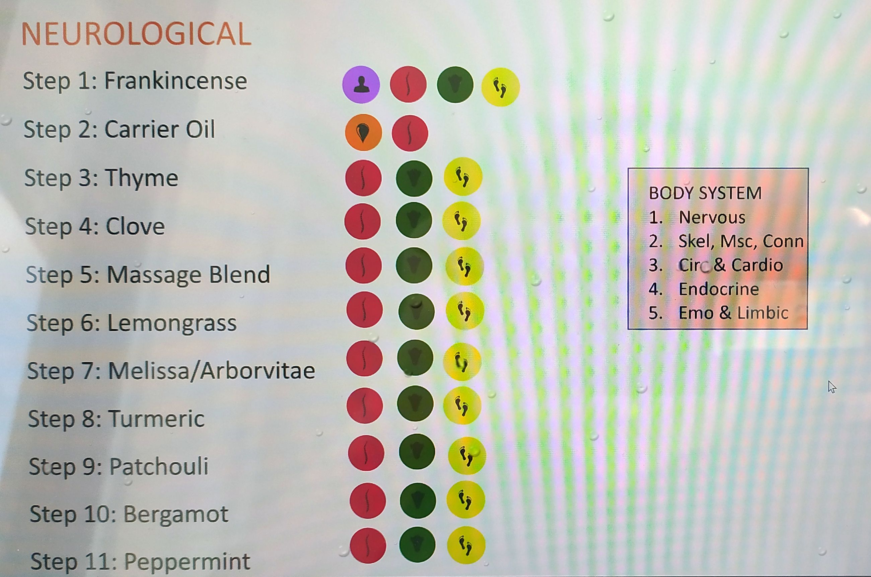
Notes:
When societies come together and form governments, they create a number of systems. For example we have a transportation system, an education system and a healthcare system.
What is the goal of the Transportation system?
To Move people and things from one place to another.
What is the goal of the education system?
To help us be more educated.
What is the goal of the healthcare system?
To help us be healthier.

Slide 24
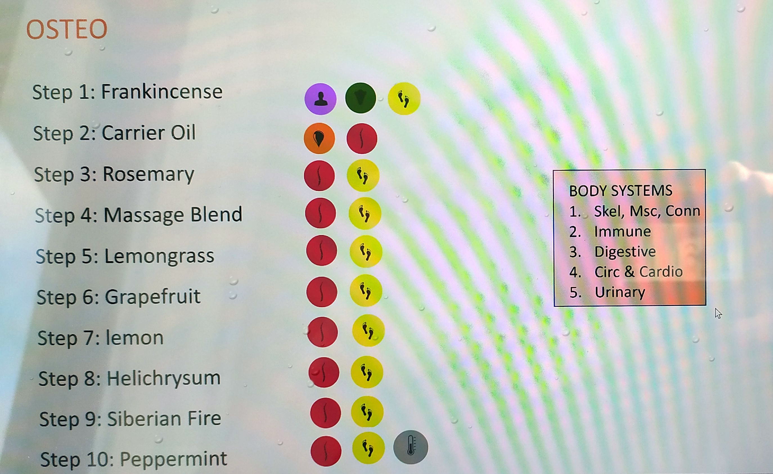
Notes:
When societies come together and form governments, they create a number of systems. For example we have a transportation system, an education system and a healthcare system.
What is the goal of the Transportation system?
To Move people and things from one place to another.
What is the goal of the education system?
To help us be more educated.
What is the goal of the healthcare system?
To help us be healthier.

Slide 25
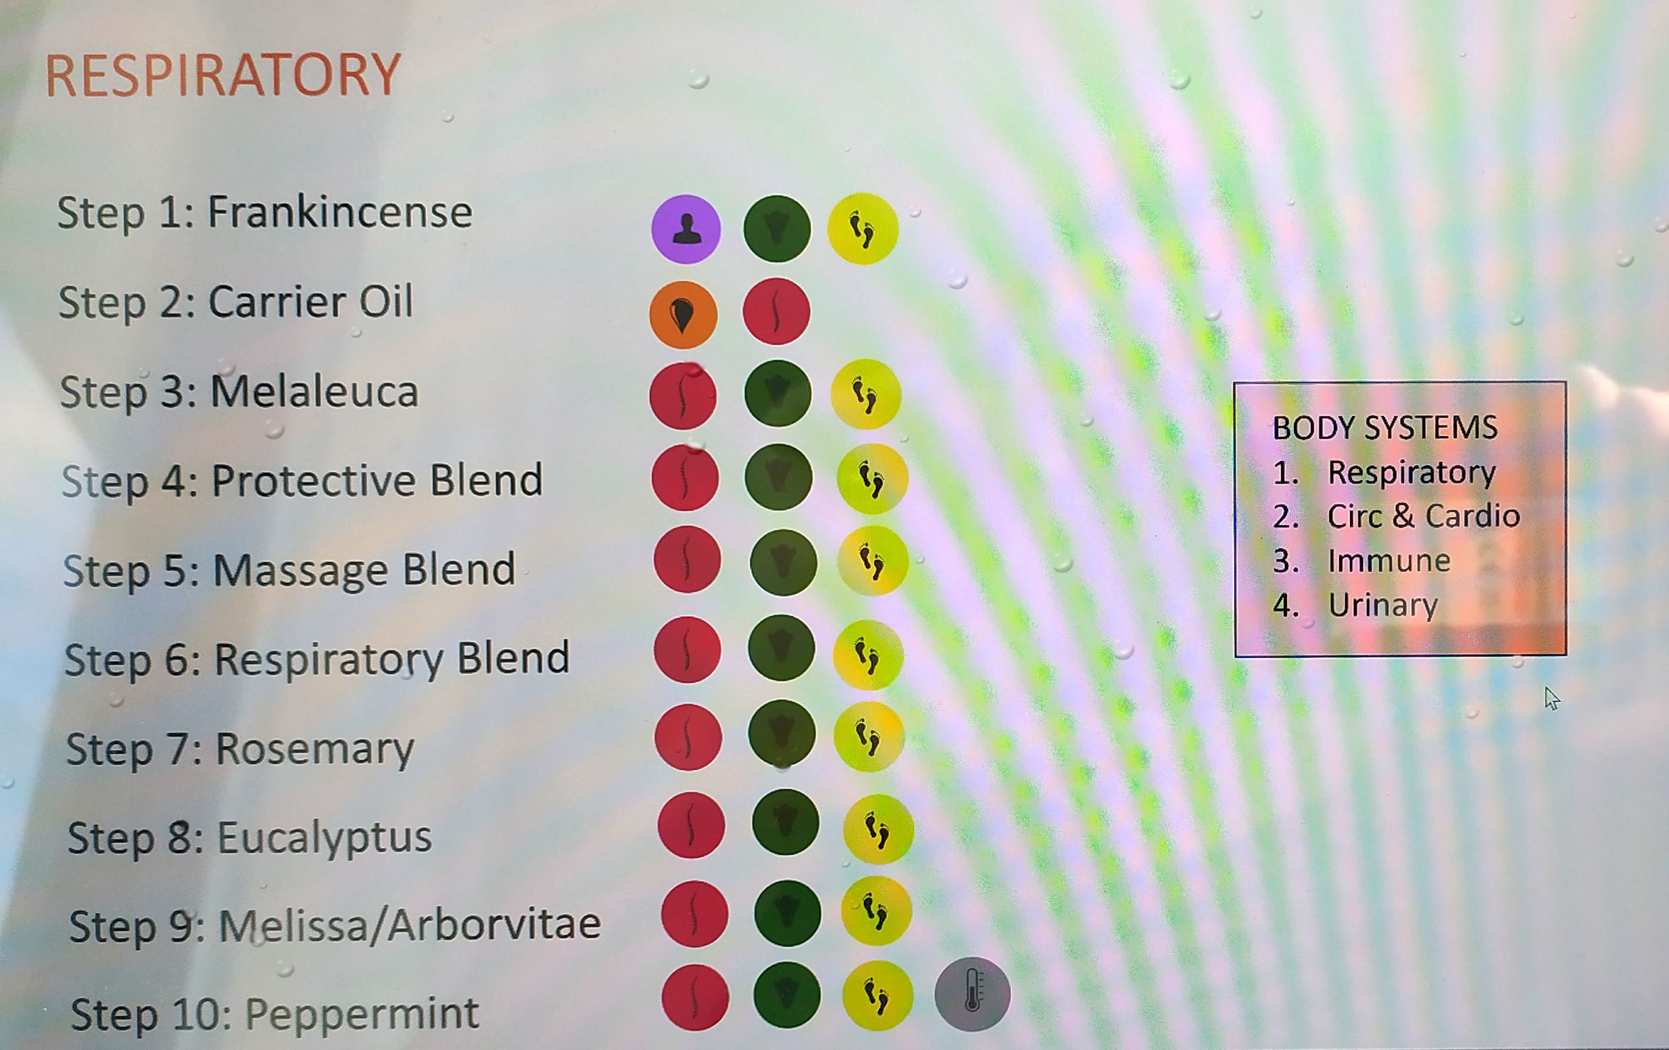
Notes:
When societies come together and form governments, they create a number of systems. For example we have a transportation system, an education system and a healthcare system.
What is the goal of the Transportation system?
To Move people and things from one place to another.
What is the goal of the education system?
To help us be more educated.
What is the goal of the healthcare system?
To help us be healthier.

Slide 26
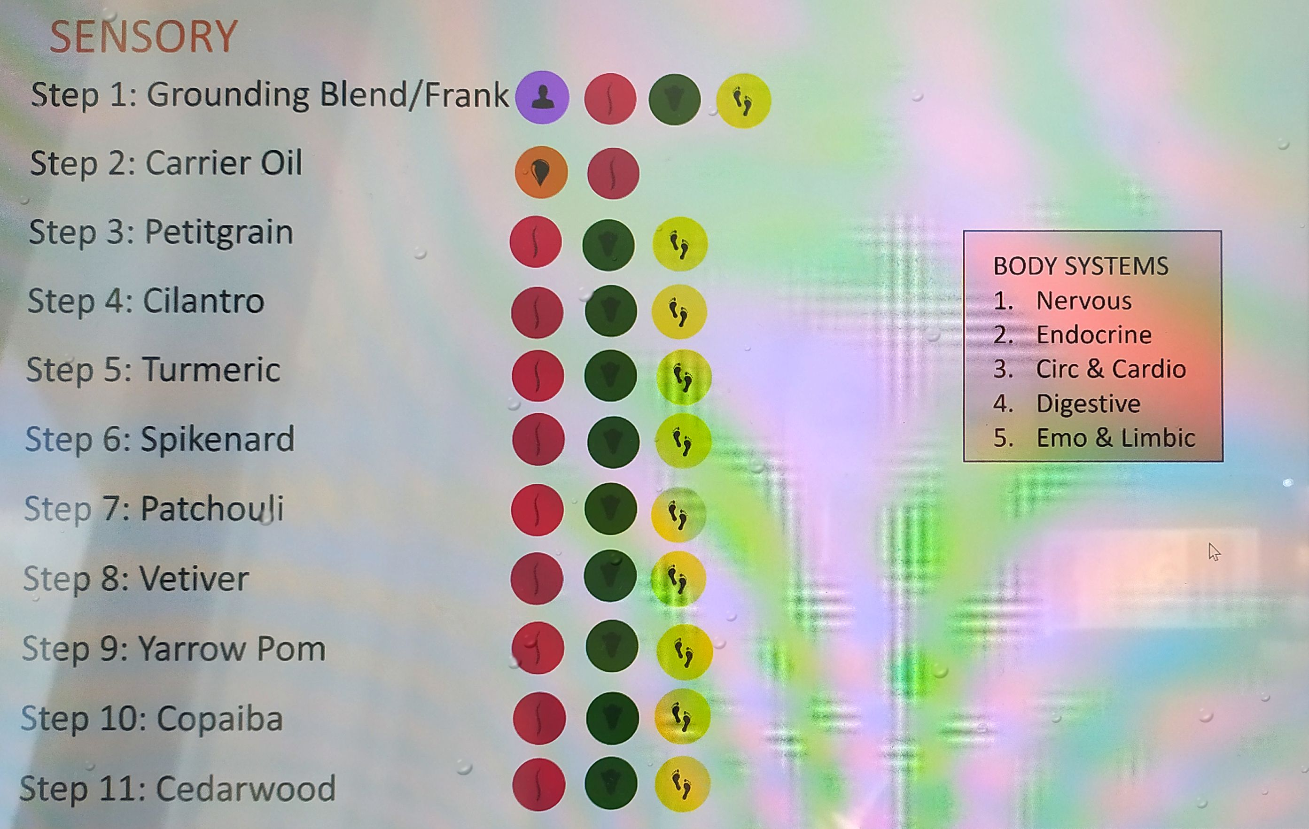
Notes:
When societies come together and form governments, they create a number of systems. For example we have a transportation system, an education system and a healthcare system.
What is the goal of the Transportation system?
To Move people and things from one place to another.
What is the goal of the education system?
To help us be more educated.
What is the goal of the healthcare system?
To help us be healthier.

Slide 27
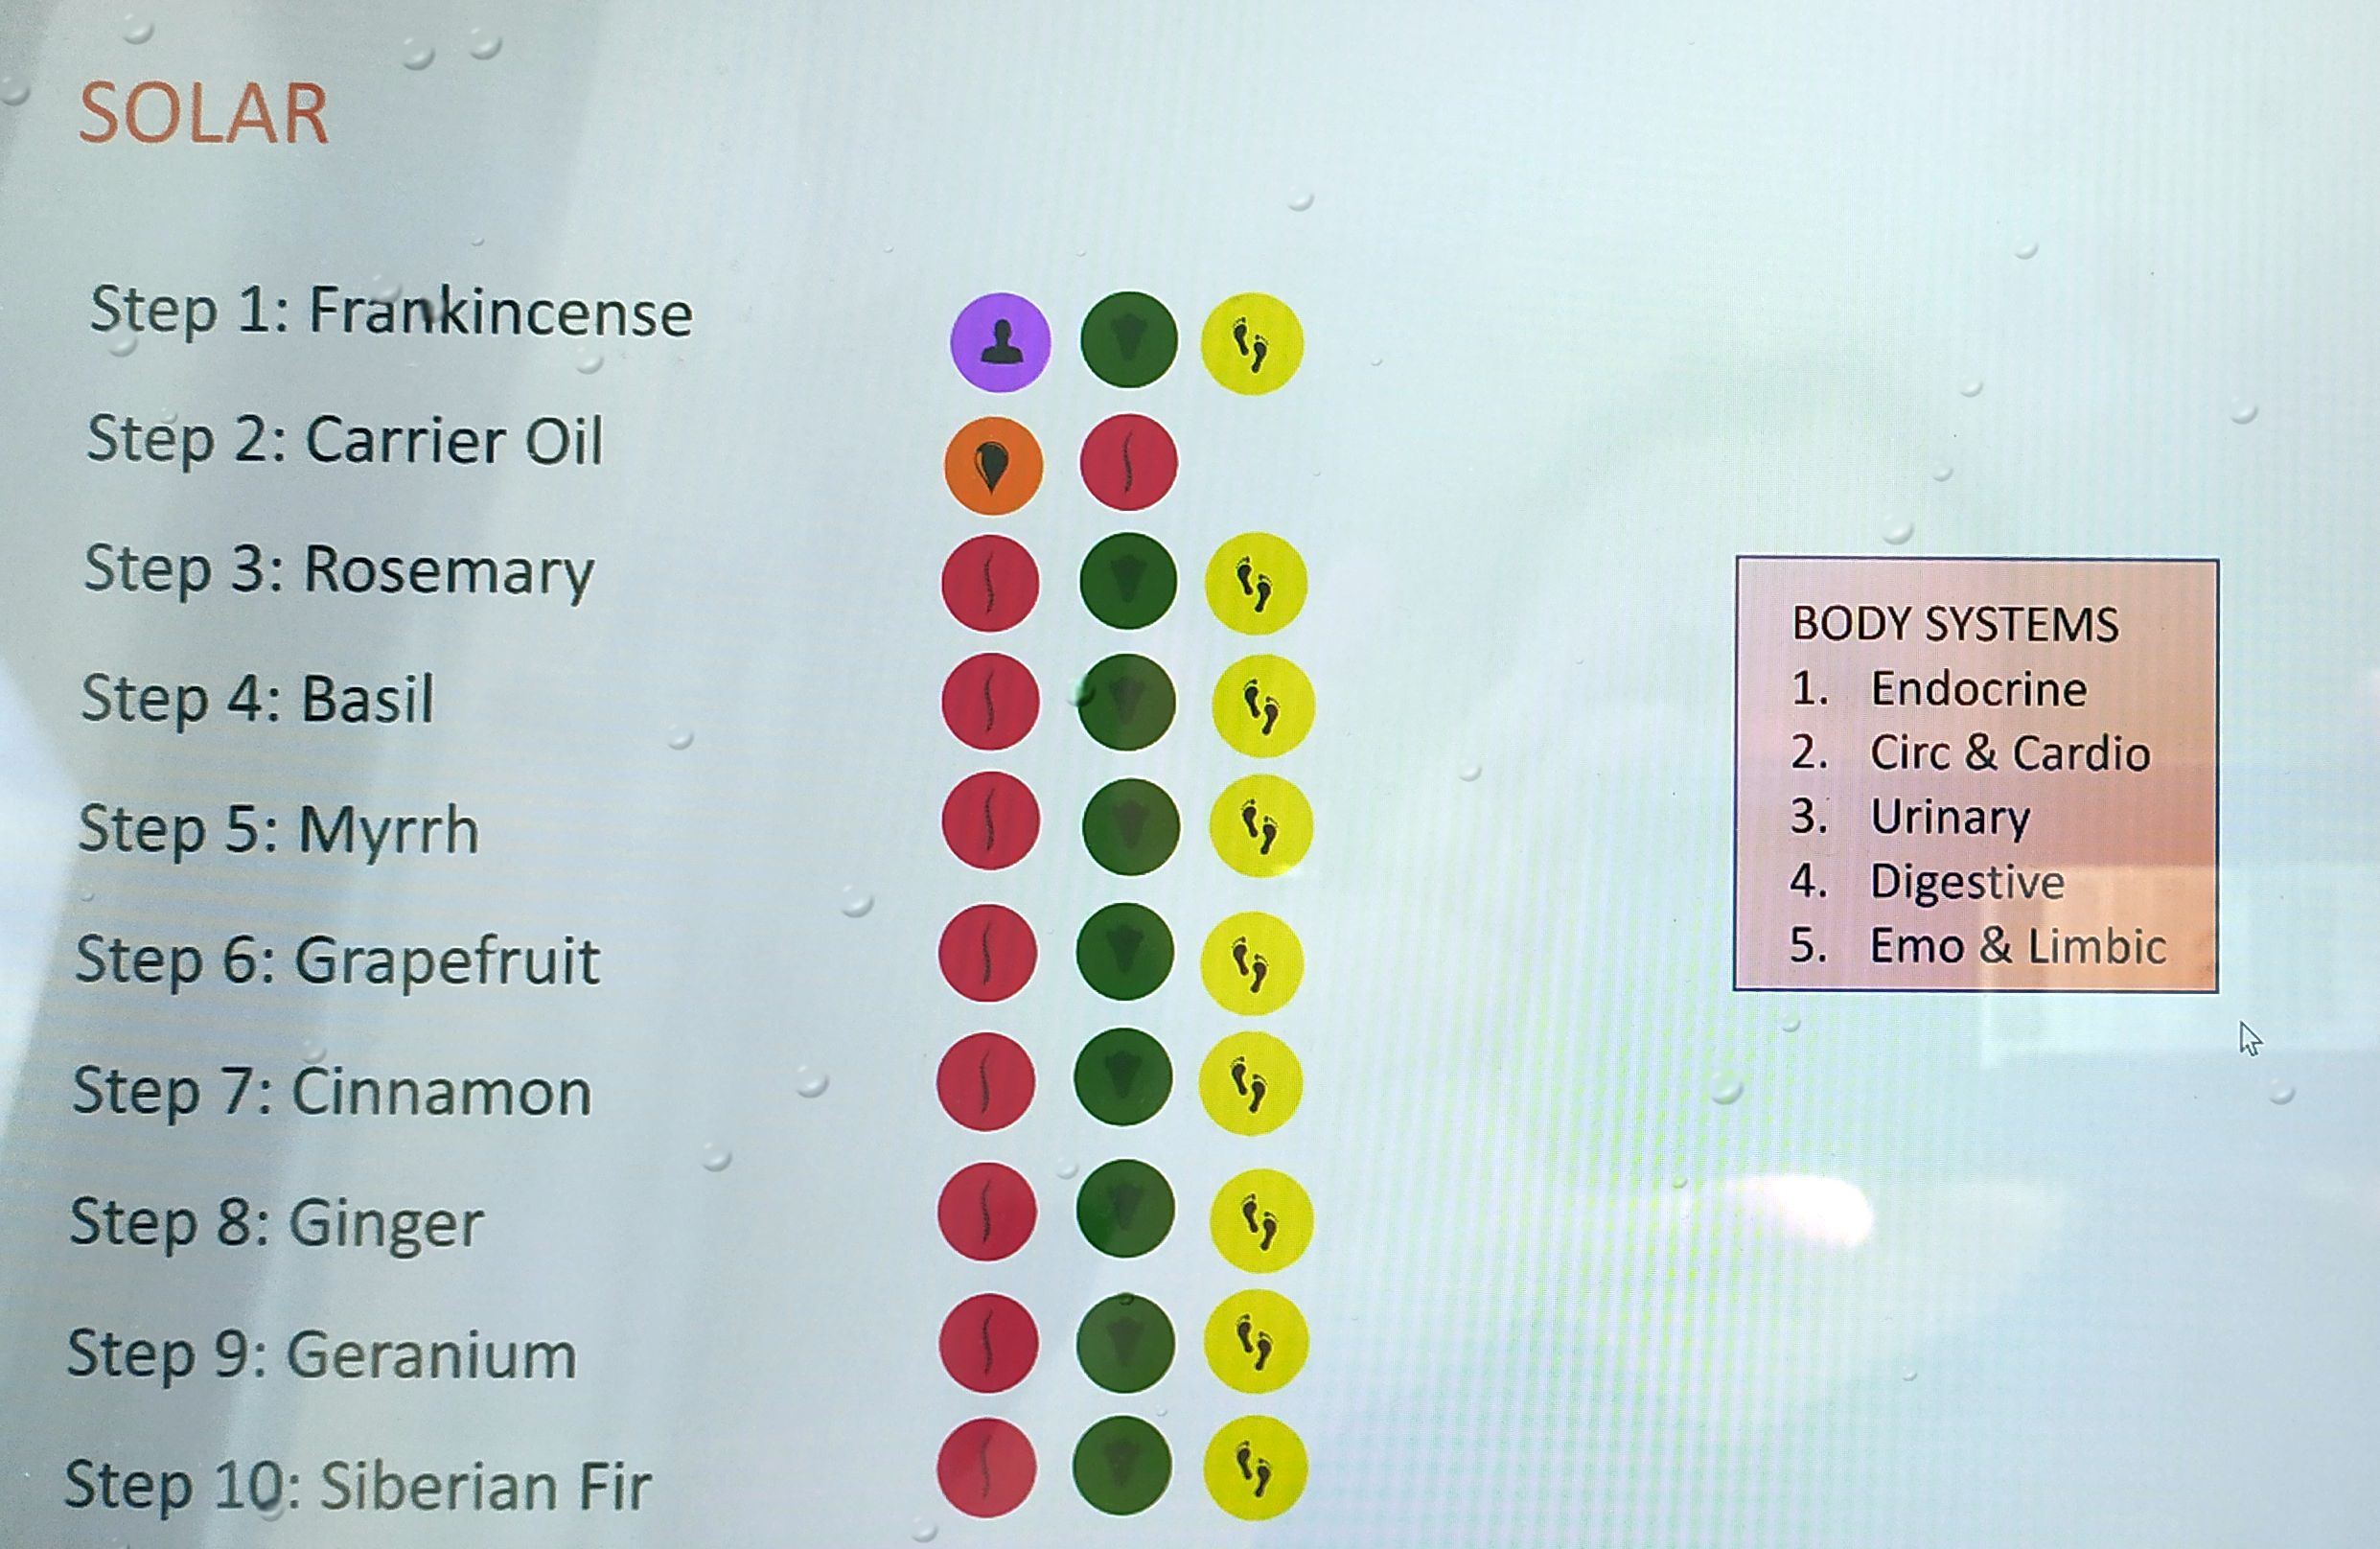
Notes:
When societies come together and form governments, they create a number of systems. For example we have a transportation system, an education system and a healthcare system.
What is the goal of the Transportation system?
To Move people and things from one place to another.
What is the goal of the education system?
To help us be more educated.
What is the goal of the healthcare system?
To help us be healthier.

Slide 28
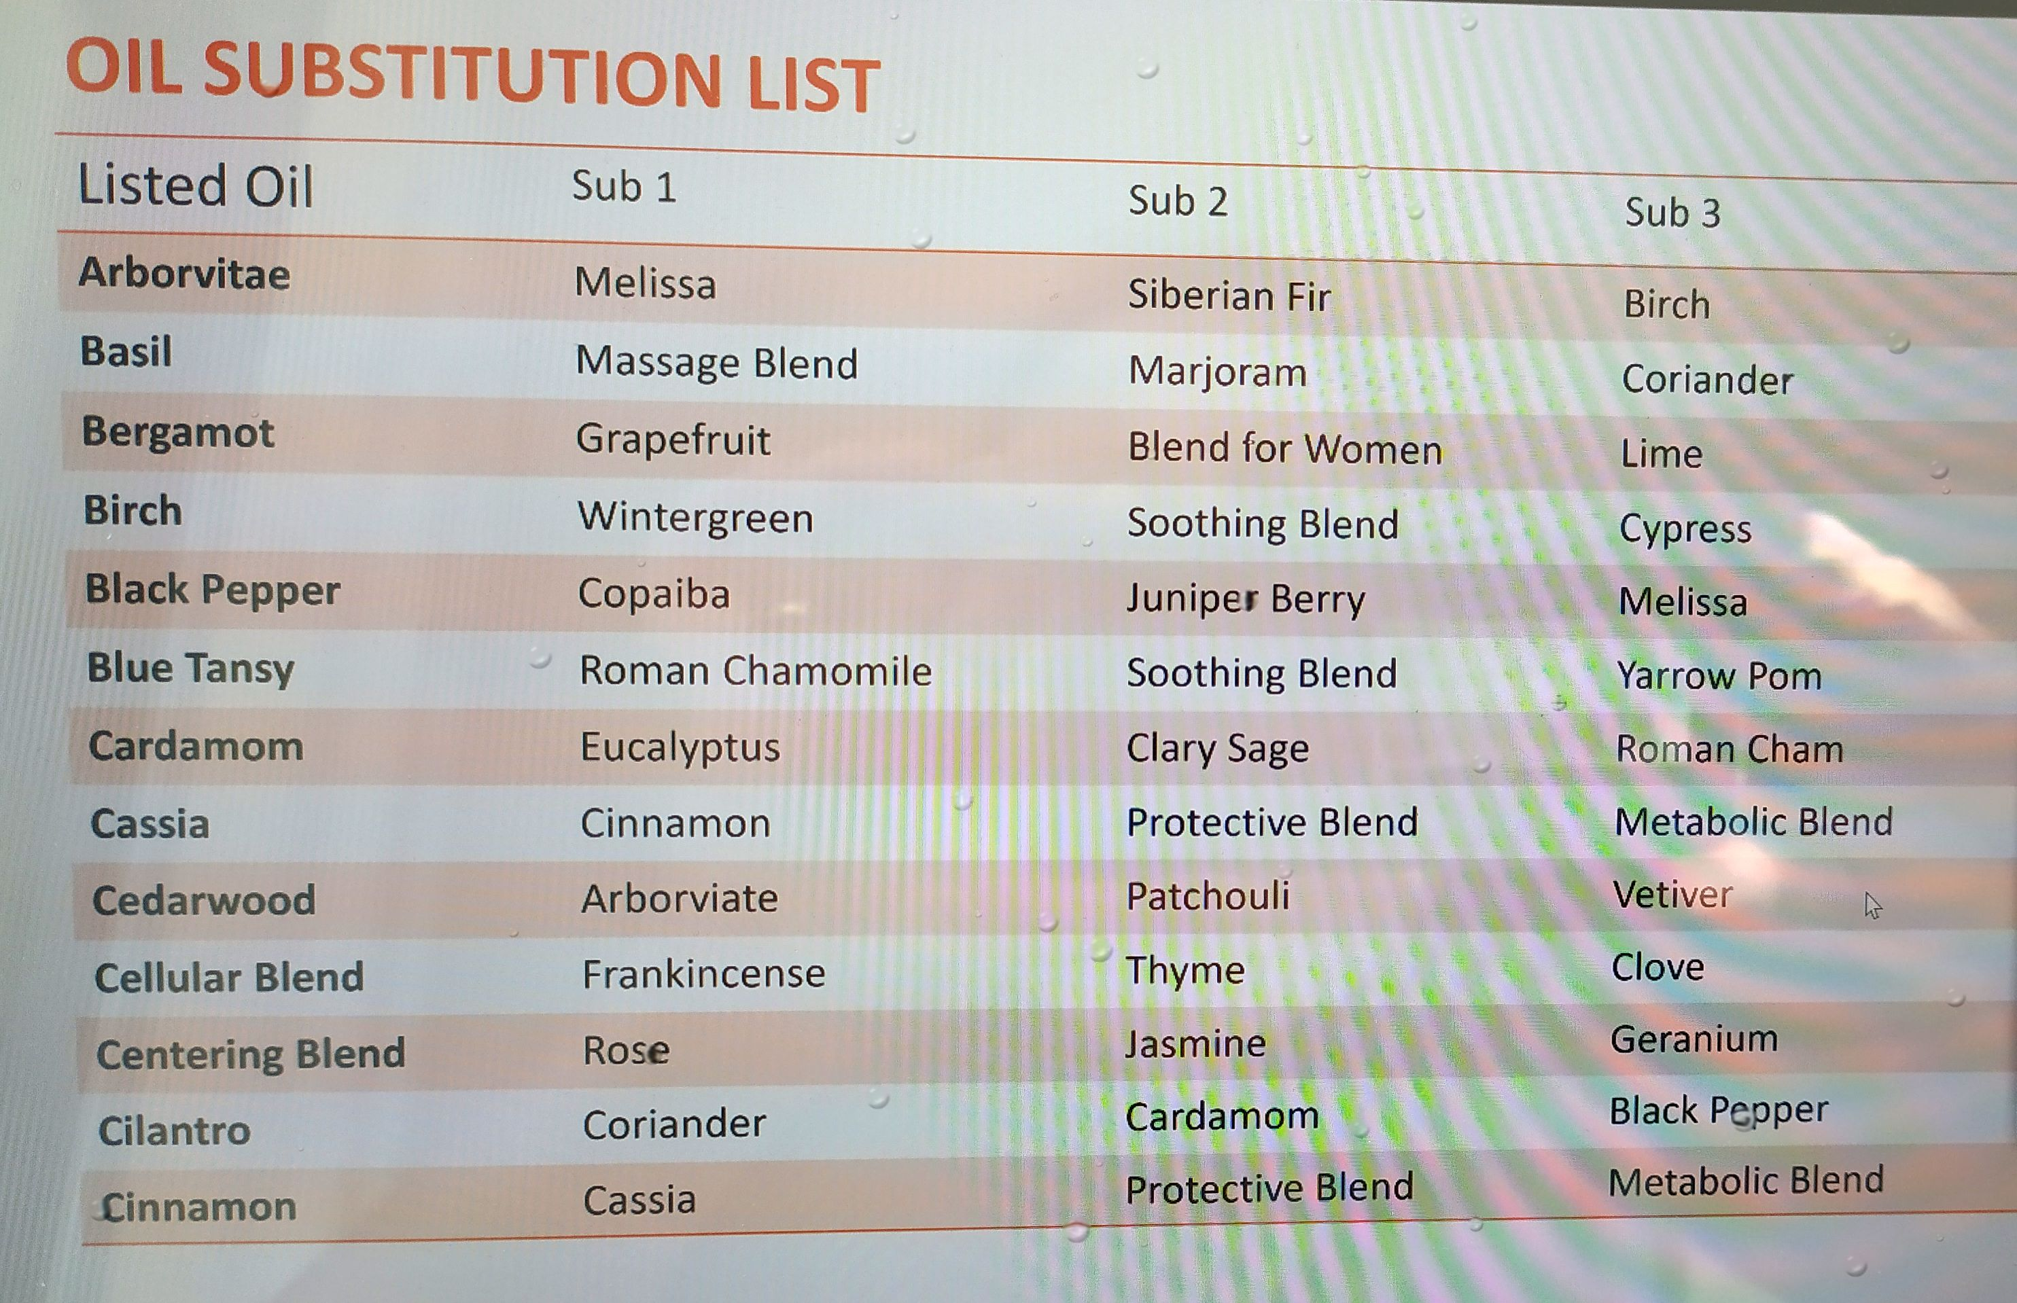
Notes:
When societies come together and form governments, they create a number of systems. For example we have a transportation system, an education system and a healthcare system.
What is the goal of the Transportation system?
To Move people and things from one place to another.
What is the goal of the education system?
To help us be more educated.
What is the goal of the healthcare system?
To help us be healthier.

Slide 29
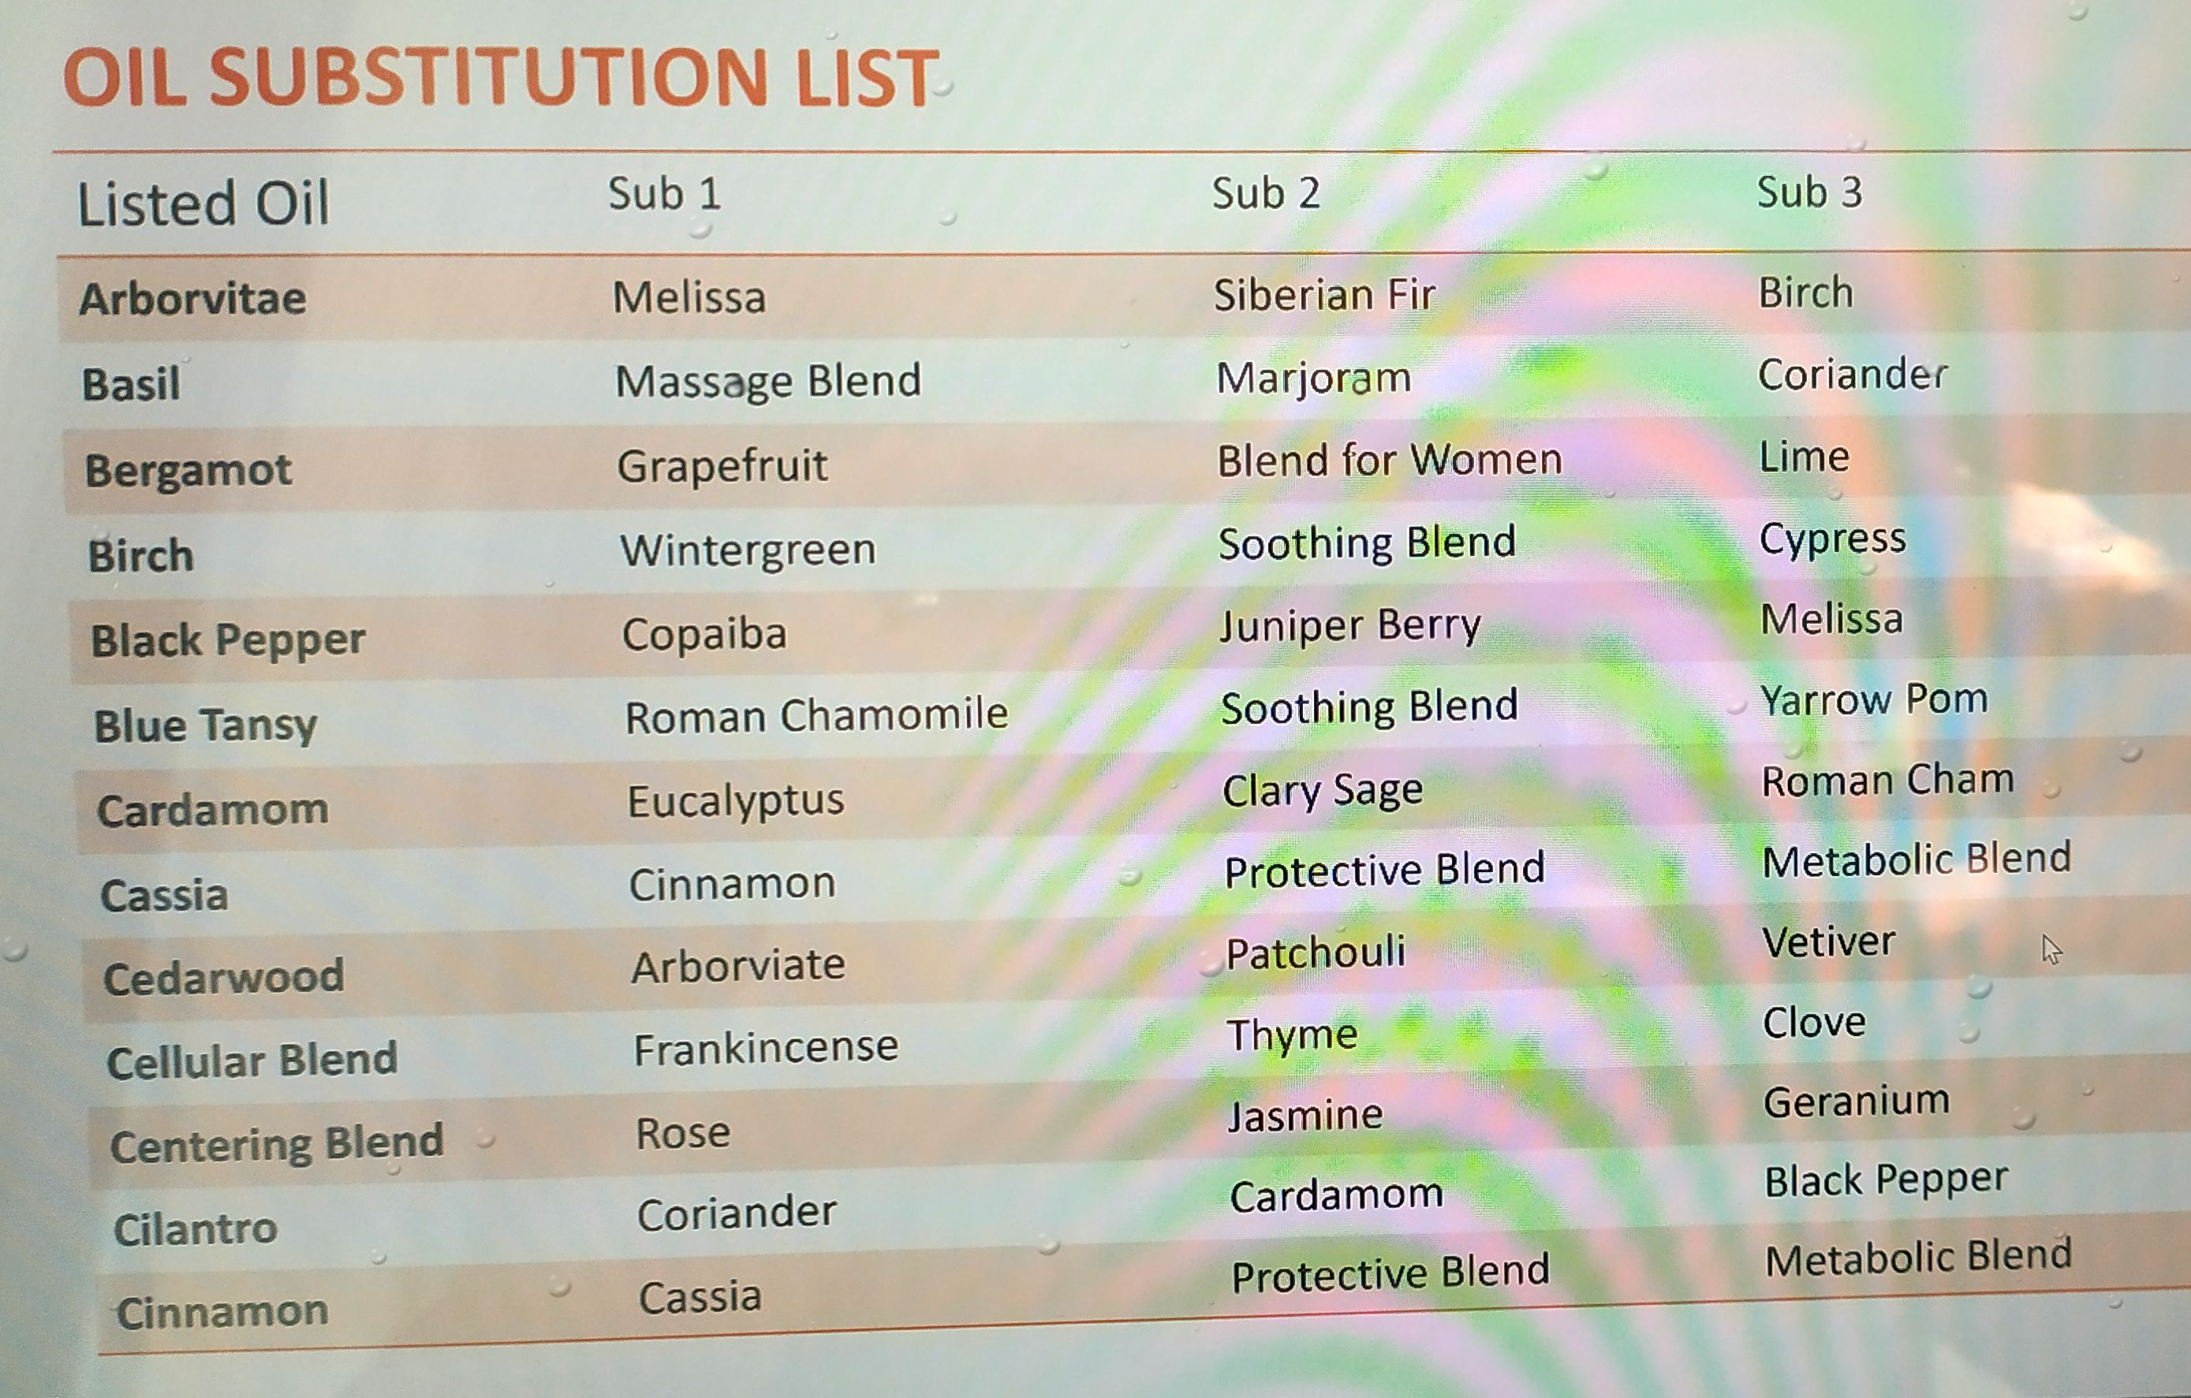
Notes:
When societies come together and form governments, they create a number of systems. For example we have a transportation system, an education system and a healthcare system.
What is the goal of the Transportation system?
To Move people and things from one place to another.
What is the goal of the education system?
To help us be more educated.
What is the goal of the healthcare system?
To help us be healthier.

Slide 30
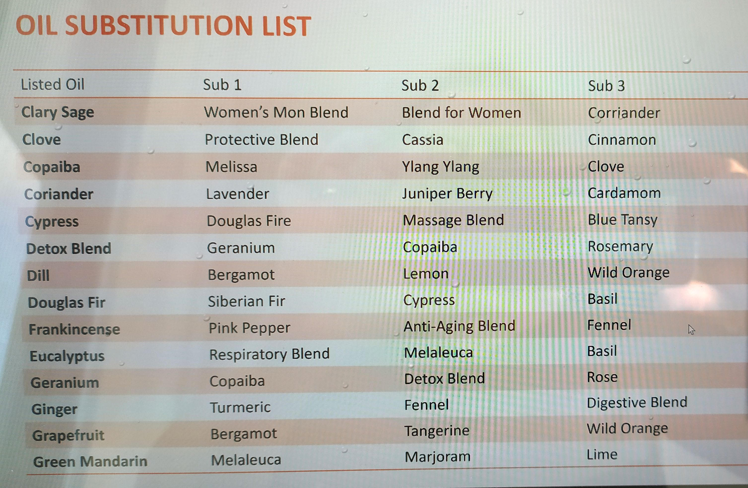
Notes:
When societies come together and form governments, they create a number of systems. For example we have a transportation system, an education system and a healthcare system.
What is the goal of the Transportation system?
To Move people and things from one place to another.
What is the goal of the education system?
To help us be more educated.
What is the goal of the healthcare system?
To help us be healthier.

Slide 31
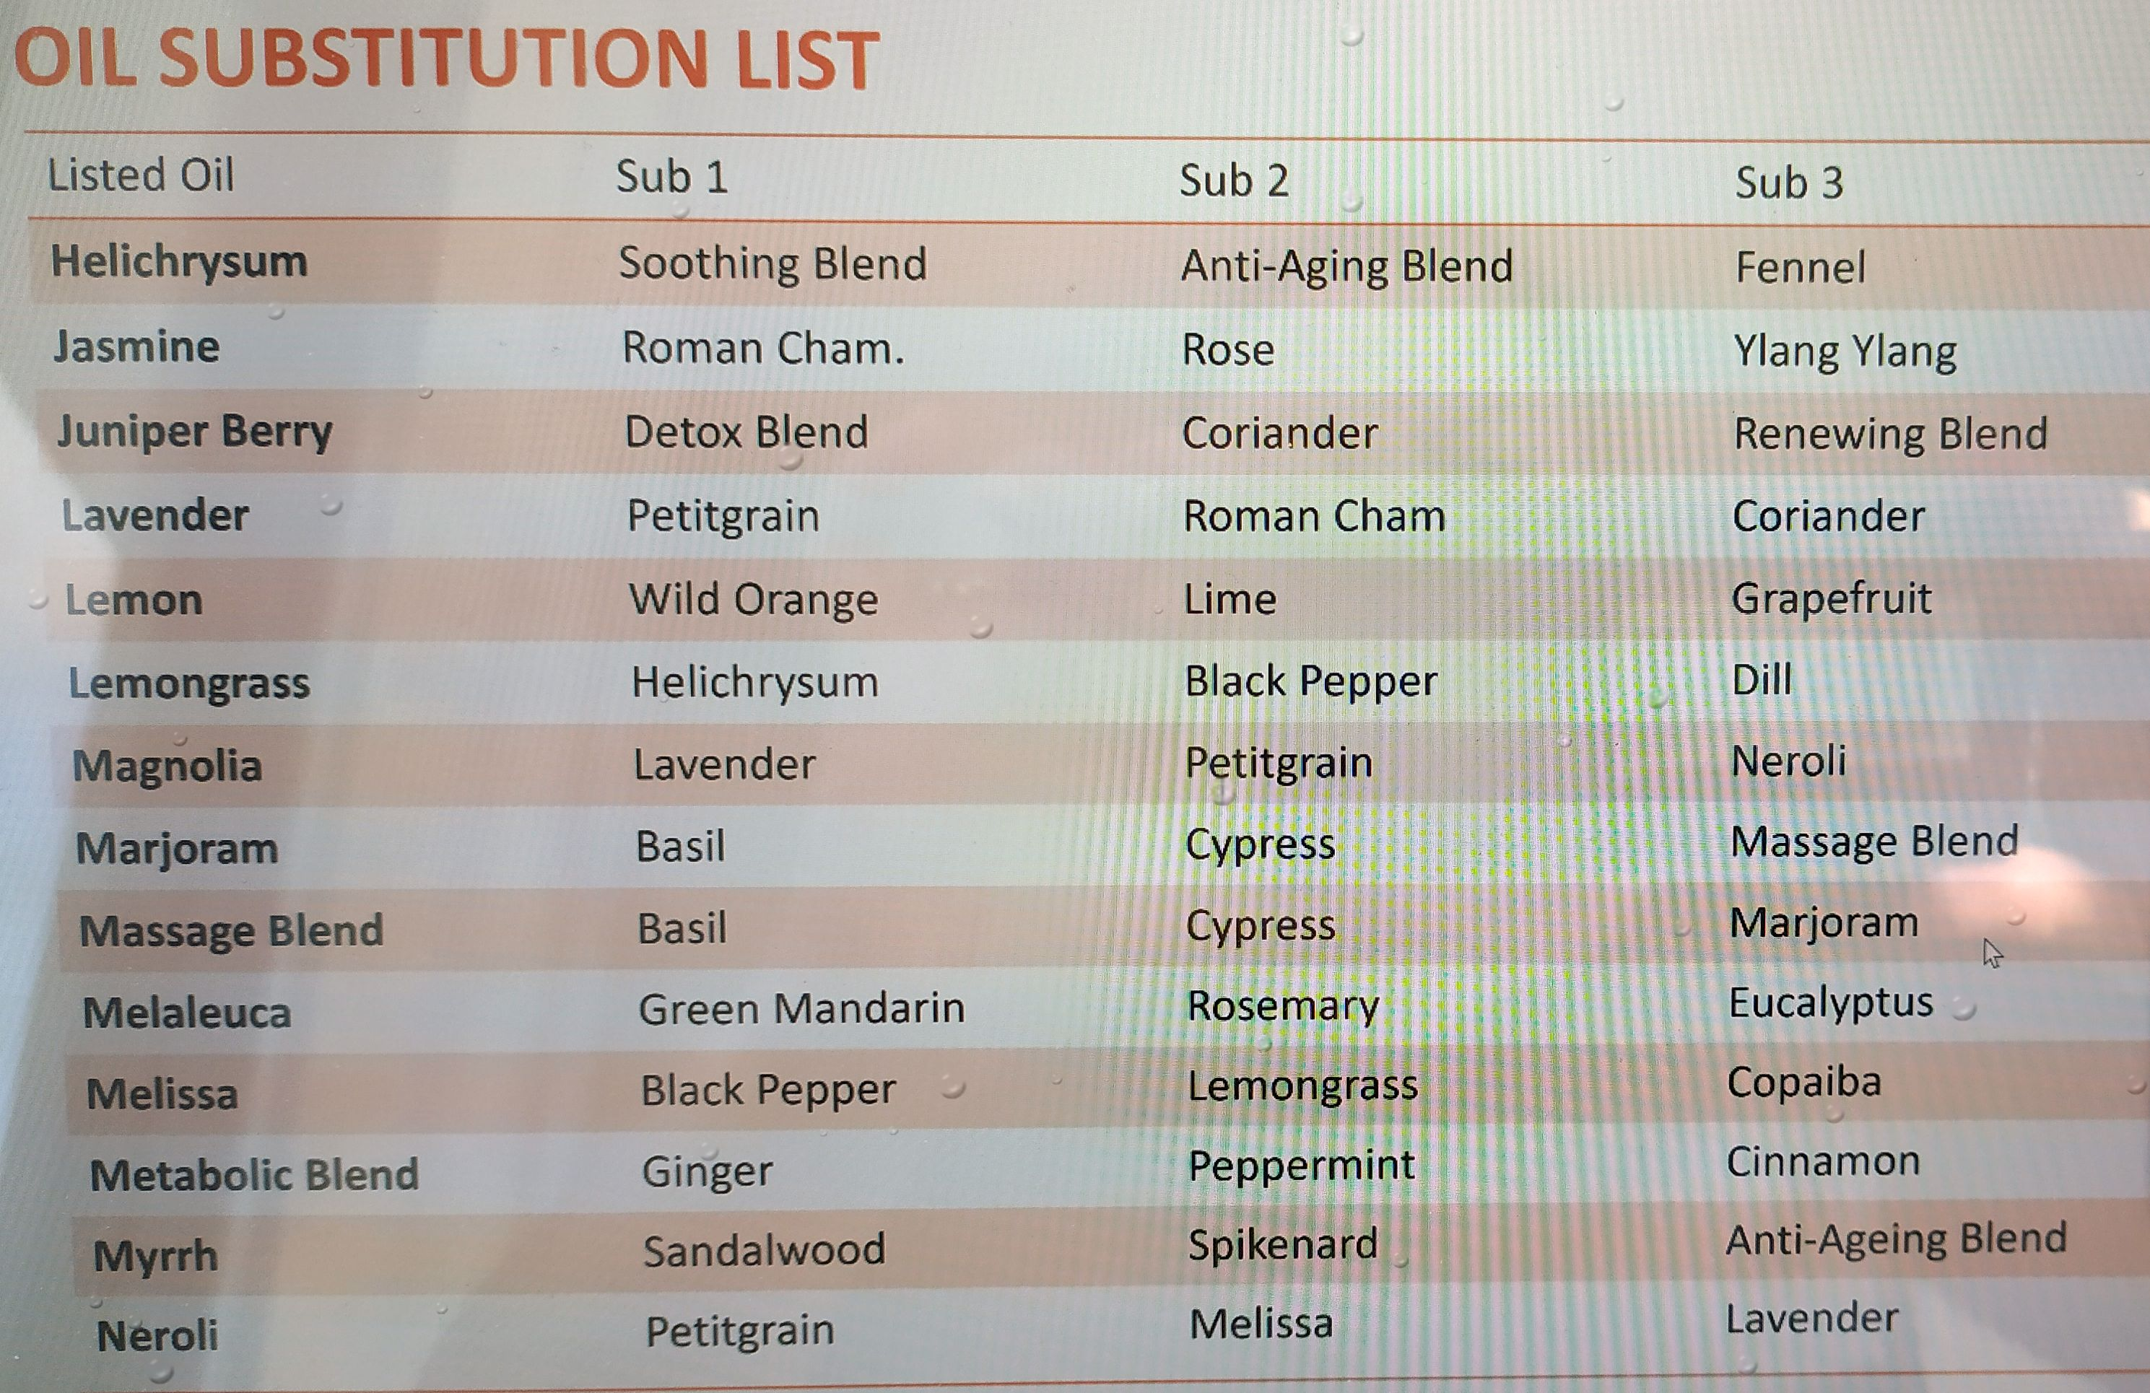
Notes:
When societies come together and form governments, they create a number of systems. For example we have a transportation system, an education system and a healthcare system.
What is the goal of the Transportation system?
To Move people and things from one place to another.
What is the goal of the education system?
To help us be more educated.
What is the goal of the healthcare system?
To help us be healthier.

Slide 32
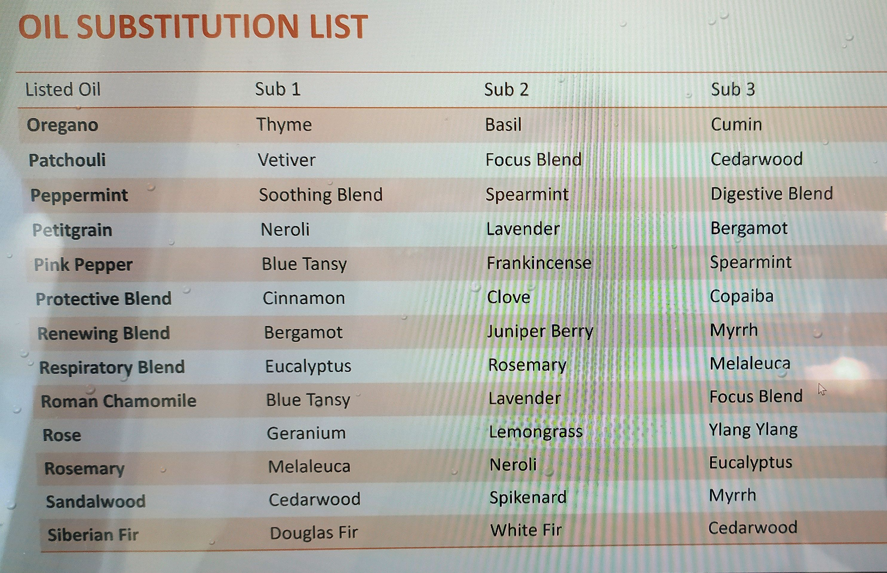
Notes:
When societies come together and form governments, they create a number of systems. For example we have a transportation system, an education system and a healthcare system.
What is the goal of the Transportation system?
To Move people and things from one place to another.
What is the goal of the education system?
To help us be more educated.
What is the goal of the healthcare system?
To help us be healthier.

Slide 33
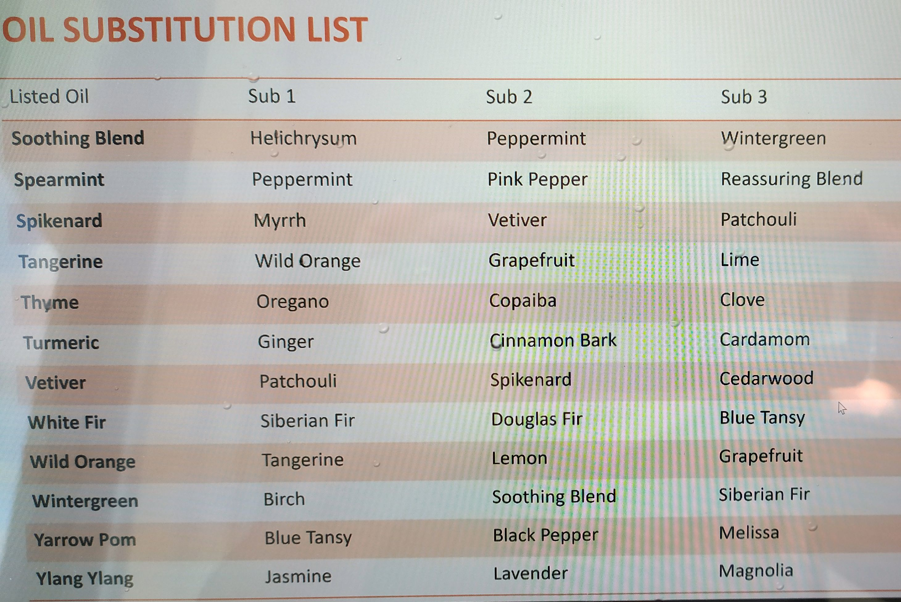
Notes:
When societies come together and form governments, they create a number of systems. For example we have a transportation system, an education system and a healthcare system.
What is the goal of the Transportation system?
To Move people and things from one place to another.
What is the goal of the education system?
To help us be more educated.
What is the goal of the healthcare system?
To help us be healthier.

Slide 34
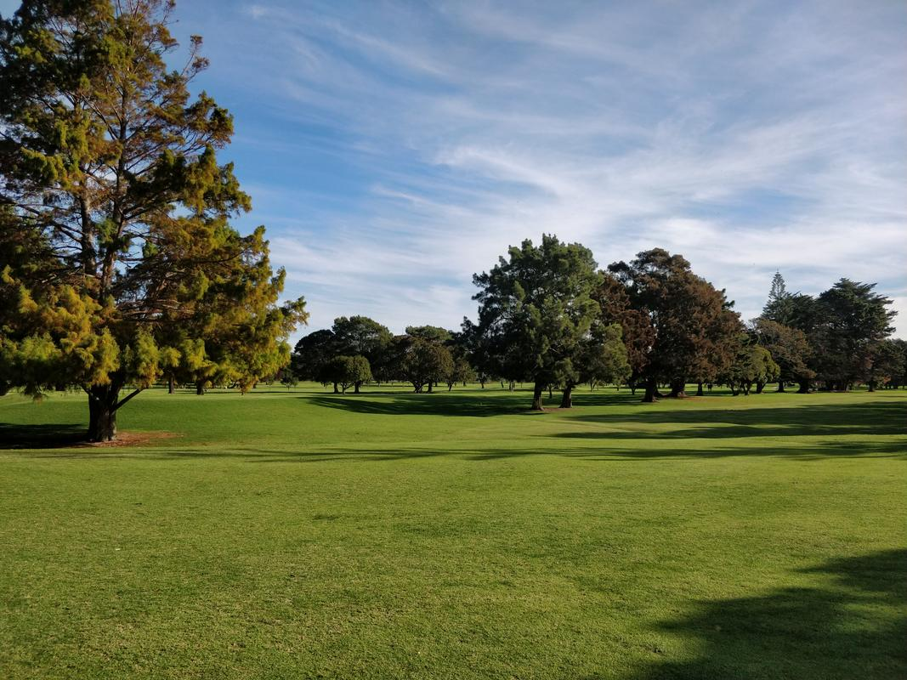
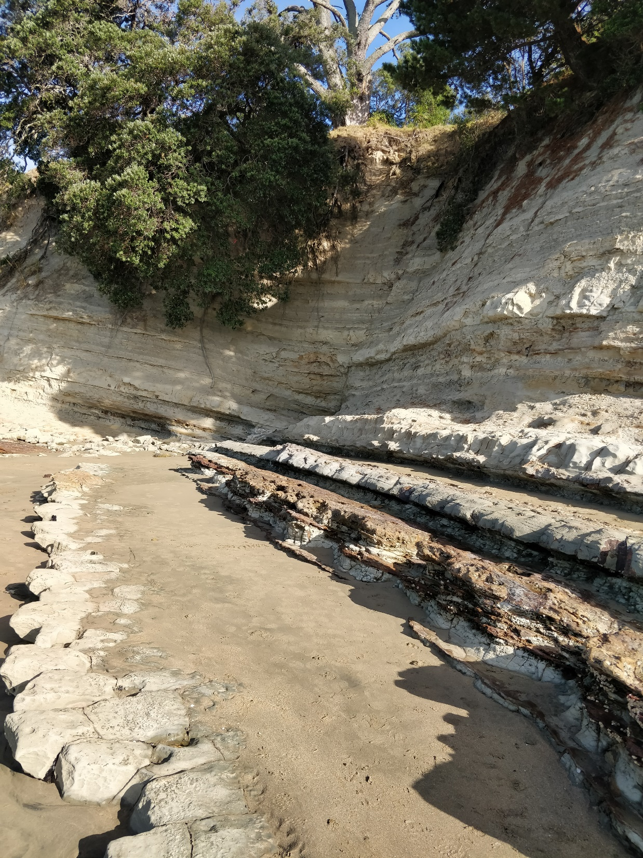
Notes:
When societies come together and form governments, they create a number of systems. For example we have a transportation system, an education system and a healthcare system.
What is the goal of the Transportation system?
To Move people and things from one place to another.
What is the goal of the education system?
To help us be more educated.
What is the goal of the healthcare system?
To help us be healthier.

Slide 35
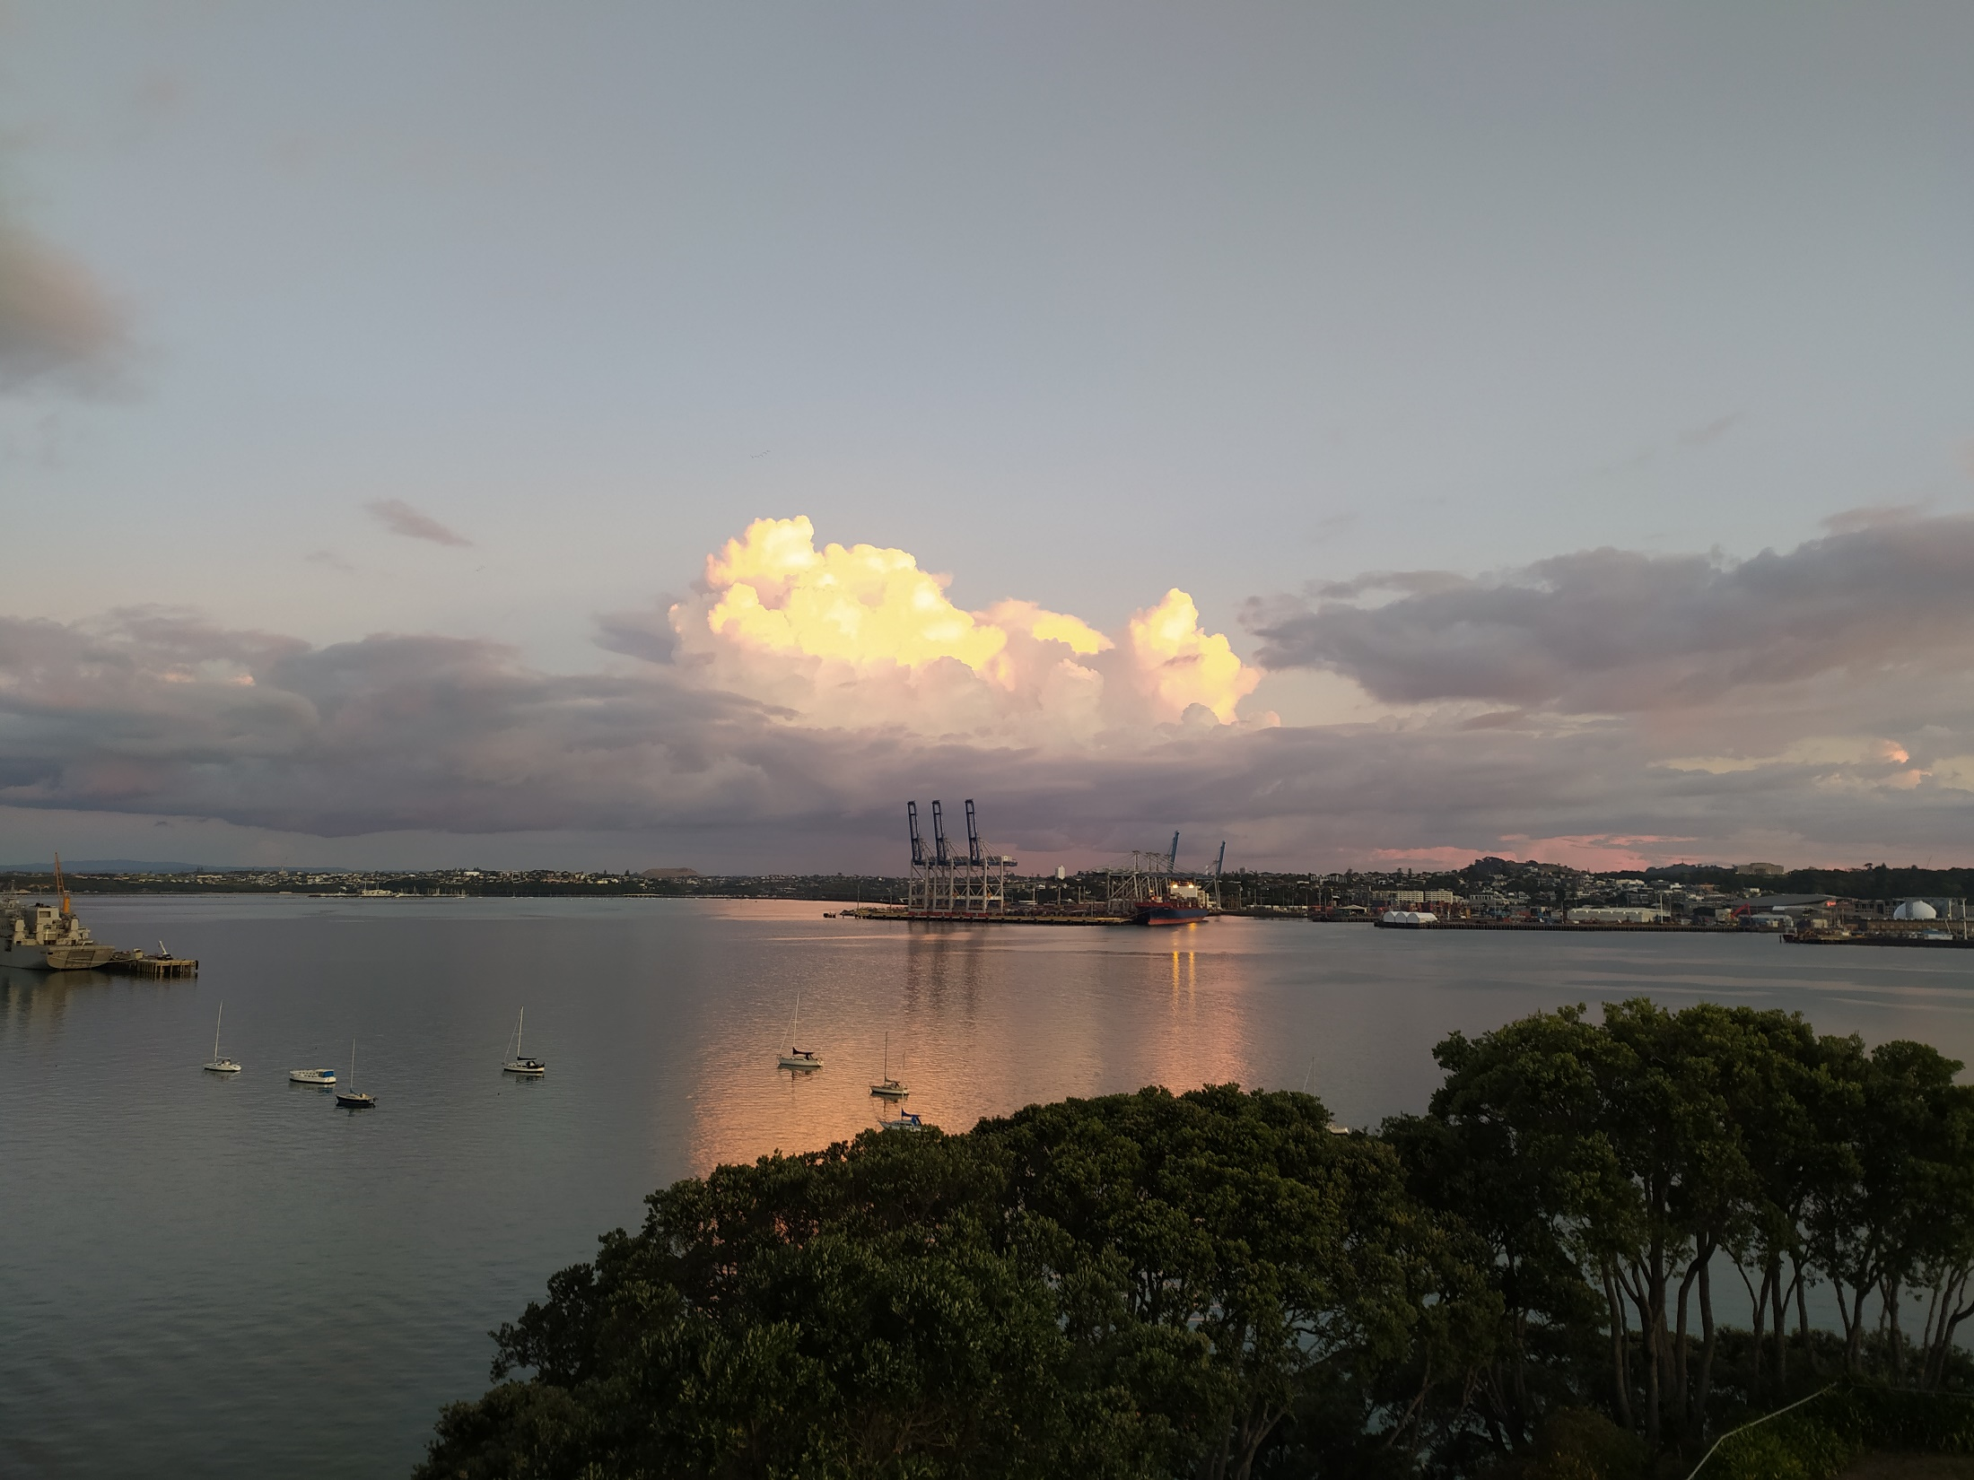
Notes:
When societies come together and form governments, they create a number of systems. For example we have a transportation system, an education system and a healthcare system.
What is the goal of the Transportation system?
To Move people and things from one place to another.
What is the goal of the education system?
To help us be more educated.
What is the goal of the healthcare system?
To help us be healthier.

