Slide 1
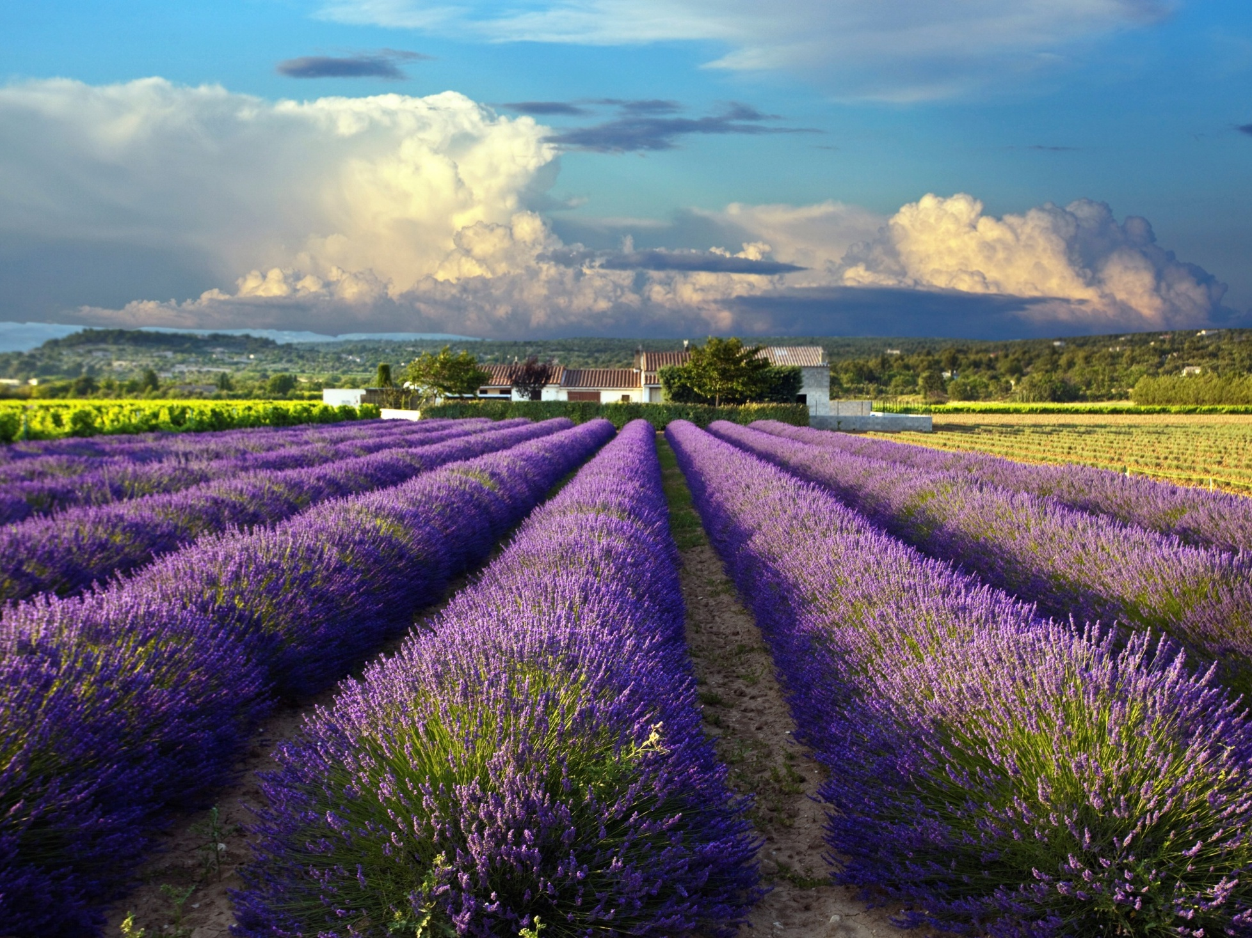


Slide 2
Keď sen sa stane skutočnosťou
Notes:
When societies come together and form governments, they create a number of systems. For example we have a transportation system, an education system and a healthcare system.
What is the goal of the Transportation system?
To Move people and things from one place to another.
What is the goal of the education system?
To help us be more educated.
What is the goal of the healthcare system?
To help us be healthier.

Slide 3
Malé listy – Na koncentráciu
Veľké listy – Na otvorenie mysle
Kvety – Na otvorenie srdca
Citrusy – Na pomoc ku zmene
Semená – Na zistenie potenciálu
Korene – Na spojenie so základmi

Slide 4
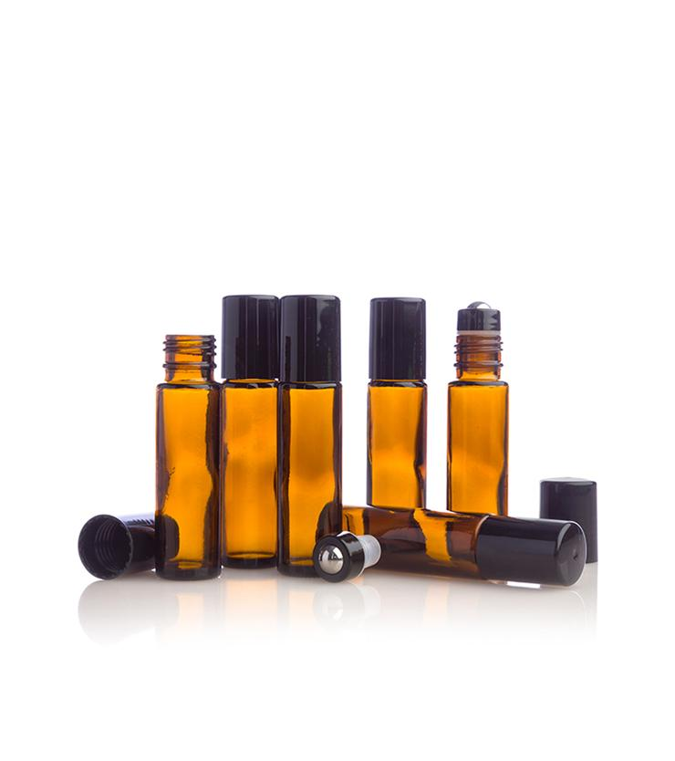
Upriamenie pozornosti
Aktivácia našej Vášne
Spearmint – 2 kv
Tangerine – 2 kv
Cedarwood – 2 kv

Slide 5
VZŤAHY
Byť prítomný
Green Mandarin – 3 kv
Ylang Ylang – 2 kv
Lavender – 1 kv
Manuka – 1 kv

Slide 6
myseľ
Načerpaj /Vyživ sa
Grapefruit – 2 kv
Siberian Fir – 2 kv
Copaiba – 2 kv
Geranium – 1 kv

Slide 7
Vyladenie sa
Kotva na vycentrovanie
Wild Orange – 2 kv
Frankincense – 1 kv
Hawaiian Sandalwood – 1 kv
Roman Chamomile – 1 kv
Arborvitae – 1 kv

Slide 8
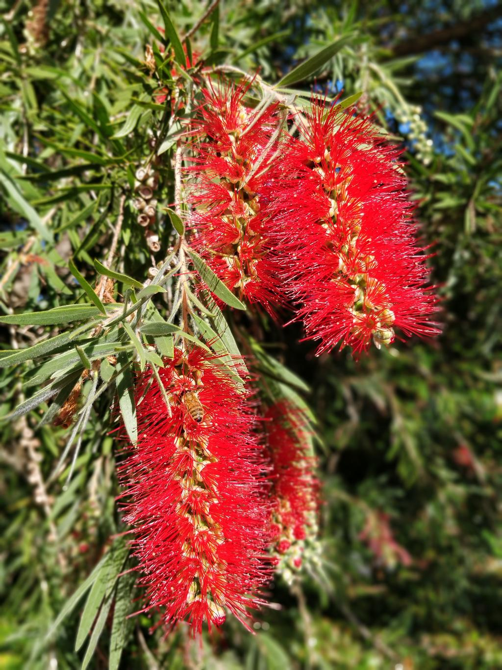
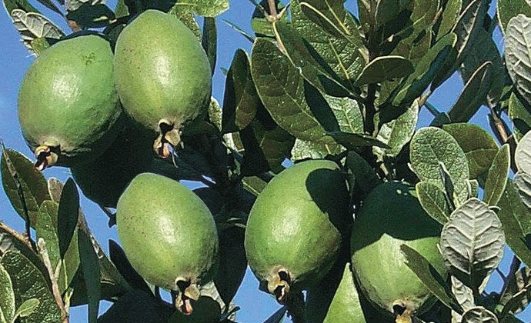
Notes:
When societies come together and form governments, they create a number of systems. For example we have a transportation system, an education system and a healthcare system.
What is the goal of the Transportation system?
To Move people and things from one place to another.
What is the goal of the education system?
To help us be more educated.
What is the goal of the healthcare system?
To help us be healthier.

